Slide 1
Modal verbs

Slide 2
When do we use modal verbs?
We use modal verbs to show if we believe something is certain, probable or possible (or not).
We also use modals to do things like talking about ability, asking permission making requests and offers, and so on.

Slide 3
The modal verbs are:
Can Could
May Might
Shall Should
Will Would
must Have to

Slide 4
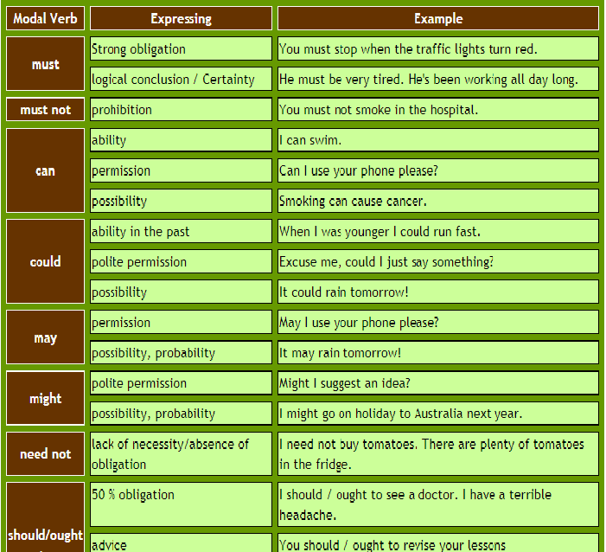

Slide 5
Modal verbs are unlike other verbs. They do not change their form (spelling) and they have no infinitive or participle (past/present). The modals must and can need substitute verbs to express obligation or ability in the different tenses. Here are some examples:

Slide 6
Past simple: Sorry I'm late. I had to finish my math test.
Present perfect: She's had to return to Korea at short notice.
Future: You'll have to work hard if you want to pass the exams.
Infinitive: I don't want to have to go.
Past simple: I couldn't/wasn't able to walk until I was 3 years old.
Present perfect: I haven't been able to solve this problem. Can you help?
Future: I'm not sure if I will be able to come to your party.
Infinitive: I would love to be able to play the piano.

Slide 7
Modals in the present and past
Generally speaking modals in the past have the following form:
Modal + have + past participle
Example:
Present: You should see a doctor.
Past: You should have seen a doctor
Except for modals that express obligation,ability and lack of necessity:
Obligation: Present = I must / have to work hard. -- Past = I had to work hard.
Ability: Present = I can run fast. -- Past = I could run fast when I was young.
Lack of necessity: Present = You don't have to / needn't take your umbrella. -- Past = You didn't have to / didn't need to take your umbrella.

Slide 8
Exercises
https://www.myenglishpages.com/site_php_files/grammar-exercise-modals.php
https://www.myenglishpages.com/site_php_files/grammar-exercise-modals-present-past.php
https://www.myenglishpages.com/site_php_files/grammar-exercise-modals-must-not-need-not.php

