Slide 1
SPEAKING PART 3 AND PHRASAL VERBS

Slide 2
Useful expressions for speaking part 3 FCE

Slide 3
Starting your discussion Shall I start? / Yeah, go on. Shall I go first? / Of course, go ahead. Is it okay if I start? / Sure, no problem. Would you like to go first? / Yes, why not? Disagreeing with your partnerI’m afraid I don’t see it the same way. I’m sorry but I have to disagree. You may be right, but I have a different view. That might be true, but I’m not sure I agree with you. I’m sorry, but I don’t agree. | Expressing your opinionI believe/think that… In my opinion,… The way I see it,… If you ask me,… I would say that… It seems to me that… In my view… As far as I’m concerned,… Changing the subjectAs for + one of the options As to + one of the options In relation to + one of the options As regards + one of the options Regarding the question of the task, With regard to + paraphrased question | Asking for your partner’s opinion statement, don’t you think/agree? statement, wouldn’t you say so? statement , wouldn’t you agree? statement, right? Do you think…? Do you believe that…? What do you think about…? How about…? What about…? What’s your take on…? | Agreeing with your partnerI (totally) agree with you. You’re dead right. That’s (absolutely) true. You’re (absolutely) right. That’s a great idea. I couldn’t agree more. Yes, I see what you mean. I see it that way, too. Yes, of course. I think so, too.

Slide 4
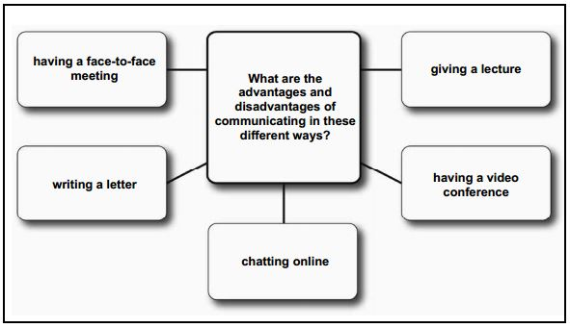

Slide 5
Phrasal verbs

Slide 6
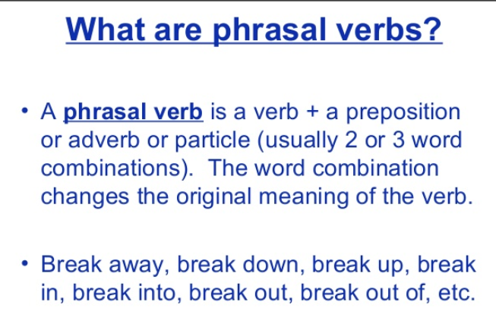

Slide 7
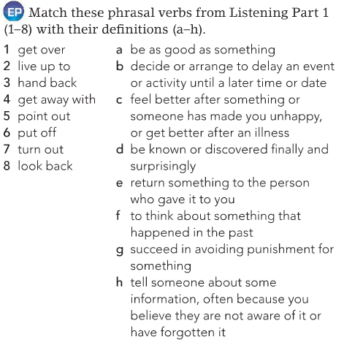

Slide 8
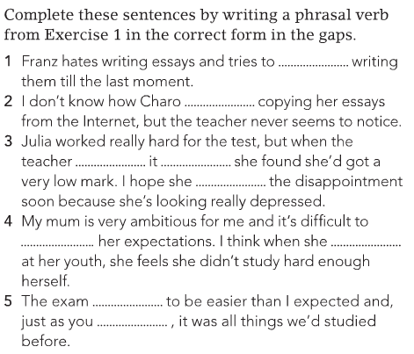

Slide 9
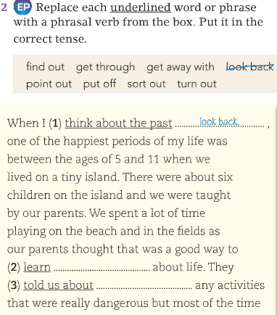
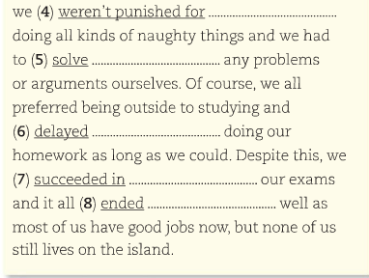

Slide 10
Think of phrasal verbs with ´up´

Slide 11
Try to replace the following expressions containing ´up´wih syononyms

Slide 12
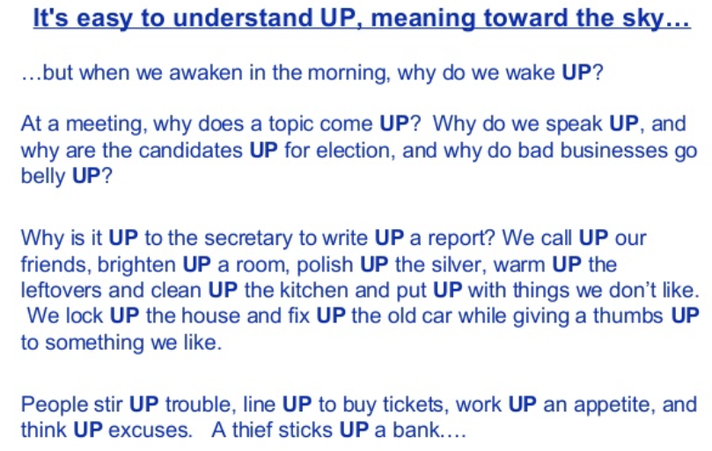

Slide 13
Select the phrasal verbs from the following poem and try to rewrite them.

Slide 14
Poem with phrasal verbs, Professor Rodrigo Deusdara de Salvi You drop me off big challenge Phrasal verb may cause damage Pointing to words to pick out Won't be so easy to freak out I won't chill out this time Even with tough insight Boiling down with my task Looking forward like request Come up with good ideas Can be more like ideologias If you pile up some words You'll run over the glasses of Lords | Don't doze off a lot Or you won't catch up the plot If you cannot work out the faith Stay off and break out the cage Take apart all these sentences And you don't have ordinances Because tear words down Is like lay off the wisdom I'll run into you in the future And take you out for our pleasure I'm not a person to cheat on Let's try out to see what's going on To wrap up with this conversation I should go through with my imagination I'd like to talk down with you If you don't give me up your soul

Slide 15
Homework
1. Write a poem containing as many phrasal verbs as possibe
2. Complete part 1 and 2 from the following slides.

Slide 16
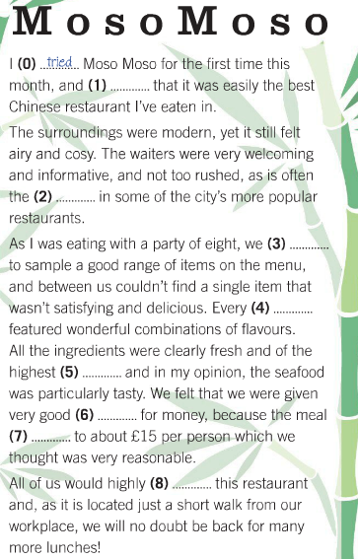
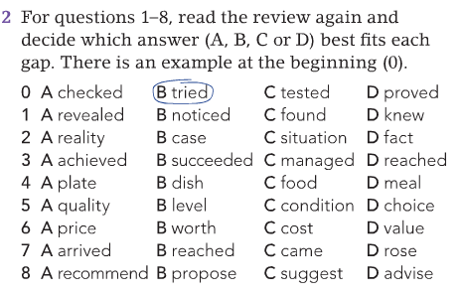

Slide 17
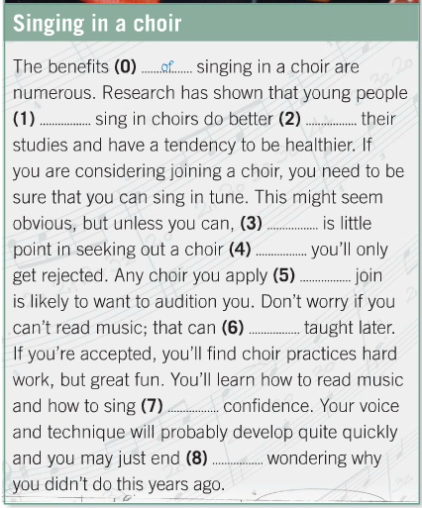
Part 2

