Slide 1
Conditionals
There are 4 main types of if sentences in English, often called conditional sentences.
These sentences are in two halves (clauses):the if part (if clause)
The other part where you can use words such as can, will, may, might, could and would (main clause)
Synonyms of “if”: unless, as long as, supposing

Slide 2
The Zero Conditional:
If + present simple, ... present simple
If you heat water to 100 degrees, it boils.

Slide 3
When do we use this conditional?
This conditional is used when the result will always happen. So, if water reaches 100 degrees, it always boils. It's a fact. We are talking in general, not about one particular situation. The result of the 'if clause' is always the main clause.
The 'if' in this conditional can usually be replaced by 'when' without changing the meaning.
For example: If water reaches 100 degrees, it boils. (It is always true, there can't be a different result sometimes). If I eat peanuts, I am sick. (This is true only for me, maybe, not for everyone, but it's still true that I'm sick every time I eat peanuts)
Here are some more examples:
If people eat too much, they get fat.
If you touch fire, you get burned.
People die if they don't eat.
You get water if you mix hydrogen and oxygen.
Snakes bite if they are scared
If babies are hungry, they cry

Slide 4
The First Conditional:
If + present simple, ... will + infinitive
If + present simple,… future simple (future simple: will + Present Simple)
If it rains tomorrow, we will go to the cinema.

Slide 5
When do we use this conditional?
It's used to talk about things which might happen in the future. Of course, we can't know what will happen in the future, but this describes possible things, which could easily come true.
Here are some more examples:
If it rains, I won't go to the park.
If I study today, I'll go to the party tonight.
If I have enough money, I'll buy some new shoes.
She'll be late if the train is delayed.
She'll miss the bus if she doesn't leave soon.
If I see her, I'll tell her.

Slide 6
The Second Conditional:
If + past simple, ... would + infinitive
If I had a lot of money, I would travel around the world.

Slide 7
When do we use this conditional?
First, we can use it to talk about things in the future that are probably not going to be true. Maybe I'm imagining some dream for example.
If I won the lottery, I would buy a big house.(I probably won't win the lottery)
If I met the Queen of England, I would say hello.
She would travel all over the world if she were rich.
She would pass the exam if she ever studied.(She never studies, so this won't happen)
Second, we can use it to talk about something in the present which is impossible, because it's not true. Have a look at these examples:
If I had his number, I would call him. (I don't have his number now, so it's impossible for me to call him).
If I were you, I wouldn't go out with that man.

Slide 8
Exercises

Slide 9
Put the verb in the correct form to complete each sentence.
1. If global warming continues, temperatures will …… (rise) even higher.
2. What would you do if you…. (win) a million dollars?
3. If people stopped using cars completely, there…. (be) much less pollution.
4. When it….. (rain) again, I won't forget to bring my umbrella.
5. If I spoke English fluently, I……. (not/need) to take lessons.
6. If Siberia ……..(not/be) so cold, I'd go there in winter.
7. Tom will be at the party tonight. If I see him, I …….(say) hello.
8. If it ……..(not/rain) so much in England, you wouldn't see so many umbrellas.
9. I……….. (call) you when I get home.
10. Where …………..(you/live) when you move out of your flat?
11. If you……………… (can) choose any company, which company would you like to work for?

Slide 10
Study each situation and complete the sentence below. Decide whether to use a first or second
1. According to the weather forecast there is a chance of snow tomorrow.
If it (snow), I (need) to buy a pair of gloves.
2. Patrick is deciding whether to go to France or Spain on his next holiday.
If Patrick (go) to Spain, he (be) very satisfied.
3. John works 12 hours a day.
If John (not/be) so busy, he (have) more time for his family.
4. Kate is out of work, but she goes shopping every day.
If Kate (continue) to go shopping, she (run out) of money.
5. It is a sunny day with clear blue skies.
If it (rain), I (need) an umbrella.
6. Anne's boss is very demanding.
If Anne's boss (not/be) so demanding, she (not/be) so stressed.
7. Daniel has an exam tomorrow.
If Daniel (pass) his exam, he (celebrate) with his friends.
8. Fabio and Carlo are best friends.
If Fabio and Carlo (not/be) best friends, they probably (not/be) living together.

Slide 11
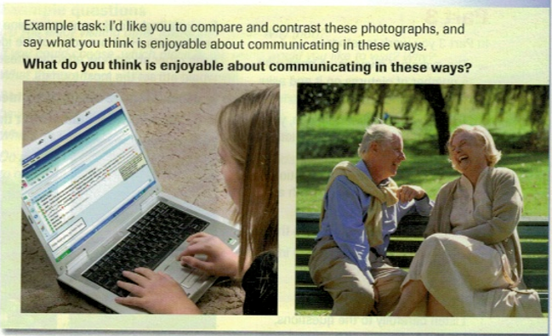
Speaking part 2

Slide 12
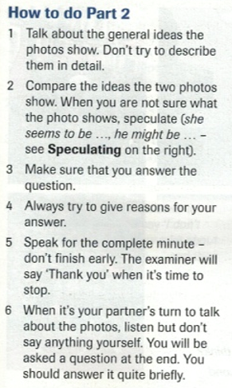

Slide 13
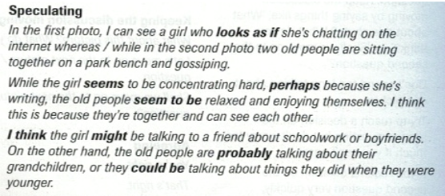

Slide 14
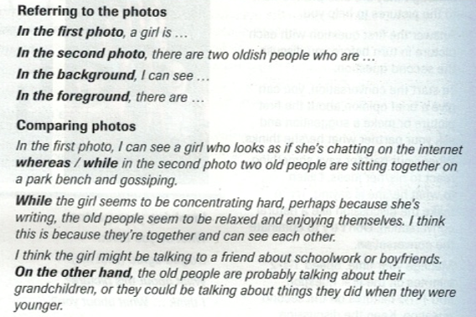

Slide 15
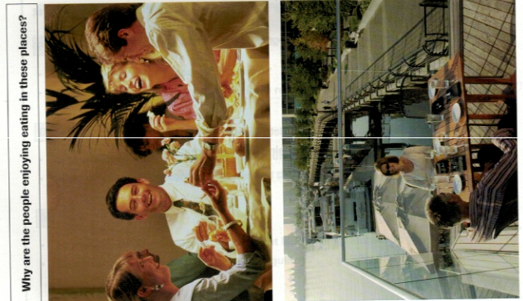
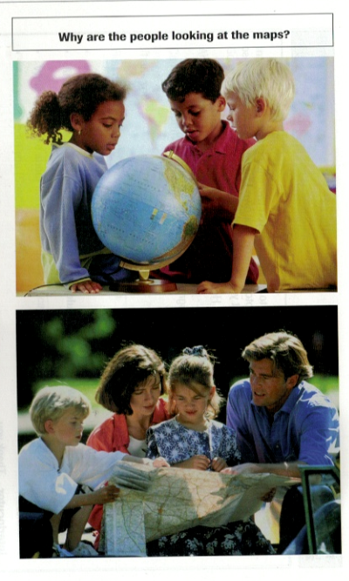

Slide 16
Homework

Slide 17
