Slide 1
The Third Conditional
If + past perfect, ... would + have + past participle
(past perfect= had+ past participle)
If I had gone to bed early, I would have caught the train.

Slide 2
When do we use this conditional?
It talks about the past. It's used to describe a situation that didn't happen, and to imagine the result of this situation.
If she had studied, she would have passed the exam (but, really we know she didn't study and so she didn't pass)
If I hadn't eaten so much, I wouldn't have felt sick (but I did eat a lot, and so I did feel sick).
If we had taken a taxi, we wouldn't have missed the plane
She wouldn't have been tired if she had gone to bed earlier
She would have become a teacher if she had gone to university
He would have been on time for the interview if he had left the house at nine

Slide 3
Exercises

Slide 4
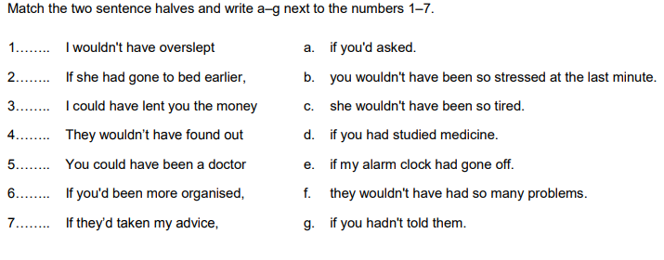

Slide 5
Complete the sentences using the third conditional.
1. He didn't get the job. He couldn't buy a bigger flat.
= If he'd got the job, _______________ a bigger flat.
2. You didn't say you were sorry. She left.
= She wouldn't have left if _______________ you were sorry.
3. You didn't tell us earlier. We didn't do anything.
= We could have done something _______________ us earlier.
4. You stopped quickly. We didn't crash.
= If you hadn't stopped quickly, _______________ crashed.
5. You didn't listen to me. This happened.
= This never would have happened if you _______________ to me.
6. You didn't apply for the job. You didn't get an interview.
= You might _______________ if you'd applied for the job.
7. I went to the party. You persuaded me to go.
= I wouldn't have _______________ me to go.
8. I didn't know she was coming. I didn’t wait for her.
= I would _______________ if I'd known she was coming.

Slide 6
Mixed conditionals

Slide 7
If clause (condition) Main clause (result)
If + past perfect present conditional
If this thing had happened that thing would happen.
EXAMPLES:
If I had worked harder at school, I would have a better job now.
I would have a better job now if I had worked harder at school.
If we had looked at the map we wouldn't be lost.
We wouldn't be lost if we had looked at the map.
If you had caught that plane you would be dead now.
You would be dead now if you had caught that plane.

Slide 8
If clause (condition) Main clause (result)
If + simple past perfect conditional
If this thing happened that thing would have happened.
EXAMPLES
If I wasn't afraid of spiders, I would have picked it up.
I would have picked it up if I wasn't afraid of spiders.
If we didn't trust him we would have sacked him months ago.
We would have sacked him months ago if we didn't trust him.
If I wasn't in the middle of another meeting, I would have been happy to help you.
I would have been happy to help you if I wasn't in the middle of another meeting.

Slide 9
Exercises

Slide 10
1.- If you ________ (be) a professional basketball player, who_________ (you/play) for?
2.- If he _________ (not study) now, he won’t have time later.
3.- If Susan had taken the map, she ________ (not get) lost.
4.- Where would you go on holiday if you _________ (can) choose?
5.- The teacher _________ (be) angry if you didn’t do your homework.
6.- What _______ (you/ give) me if it were my birthday tomorrow?
7.- If we recycle more, there _________ (not be) so much rubbish.
8.- If they had something to eat, they __________ (not be) hungry.
9.- If we _________ (hear) the weather forecast, we wouldn’t have gone to the beach.
10.- What _________ (you/buy) if you had a credit card?
11.- If they ________ (not hurry) up, they will miss the film.

Slide 11
Homework

Slide 12
Complete the sentences below with a third second mixed conditional.
1. Simon woke up early and is very sleepy now. If he (not/wake up) early, he (not/be) sleepy now.
2. I am at home now because it started raining. If it (not/start) raining, I (be) out.
3. The Spanish team didn't train well at all, so they are not champions. If they (train) well, they (be) champions.
4. I lost my job, so I need to look for work. If I (not/lose) my job, I (not/need) to look for work.
5. James won the lottery, so he doesn't need a job now. He (need) a job if he (not/win) the lottery.
6. Alan had a serious argument with his friend Paul. They are no longer friends. If Alan (not/argue) with Paul, they (still/be) friends now.
7. The meeting started late. I'm not at home yet. I (be) at home now if the meeting (start) on time.
8. Mike failed his university exams so he needs to retake them. If he (pass) them, he (not/need) to retake them.

