Slide 1
Class 1

Slide 2
Adjectives, comparatives
Small---smaller
Big----bigger
Long----longer
Adjective + er = comparative

Slide 3
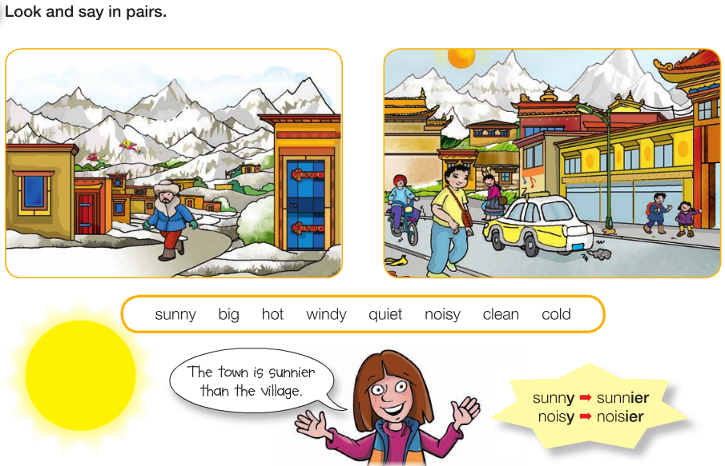

Slide 4


Slide 5
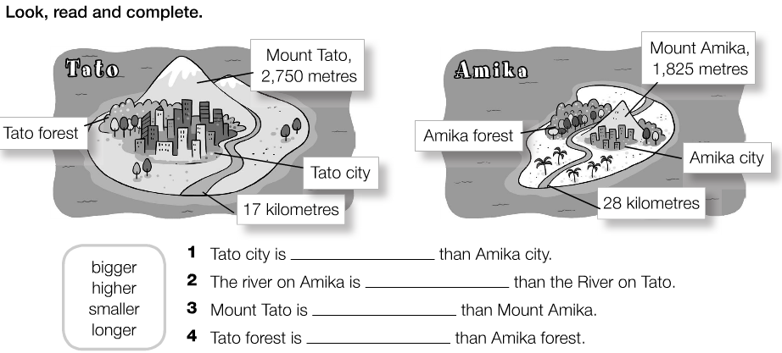

Slide 6
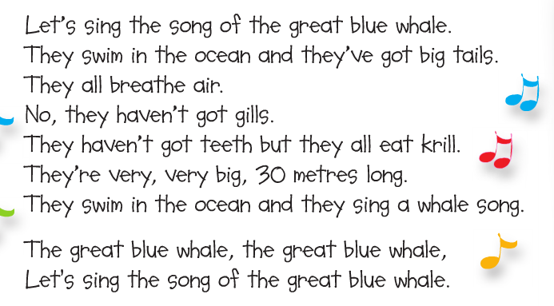

Slide 7
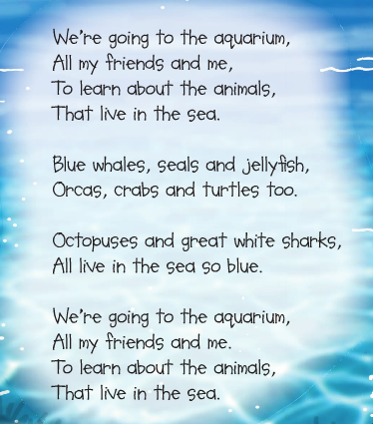

Slide 8
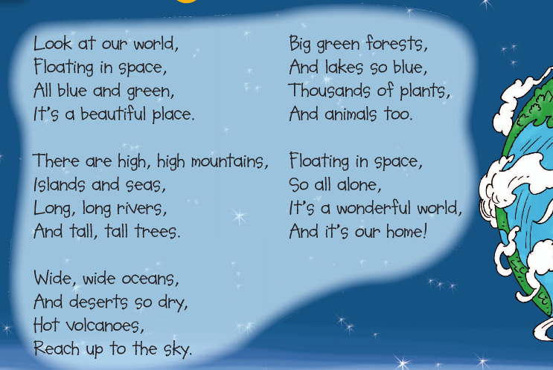

Slide 9


Slide 10
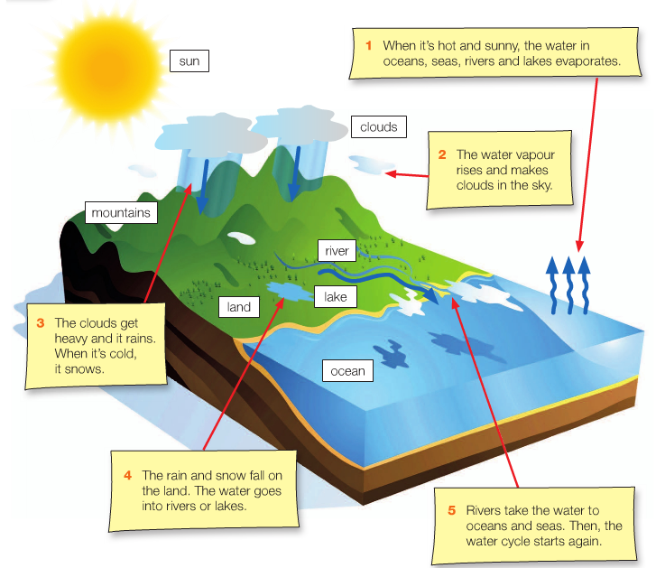

Slide 11
Play Steven.
Draw Steven together.

Slide 12
Class 2

Slide 13
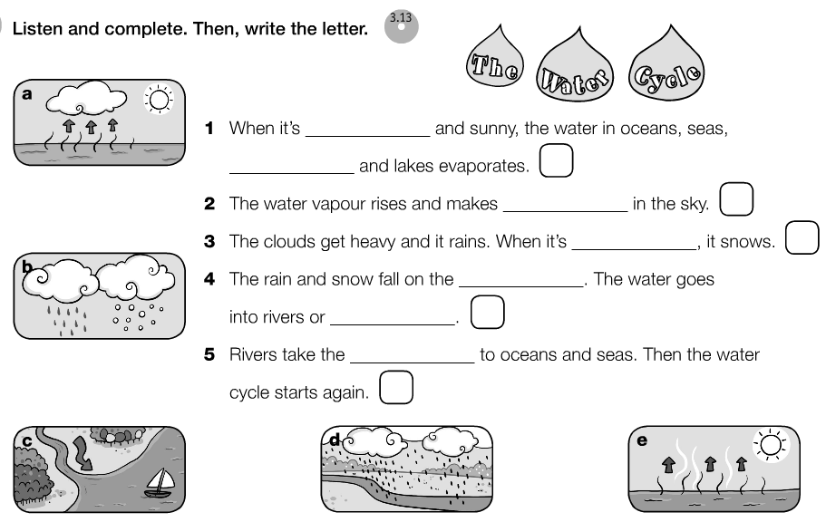

Slide 14
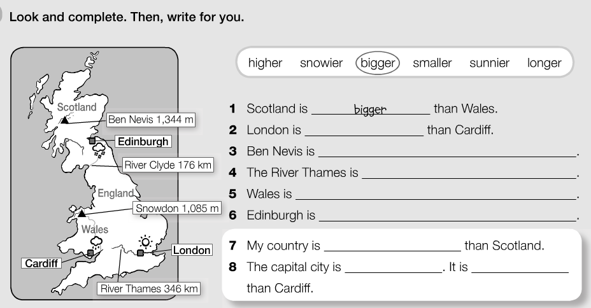

Slide 15
A long way to school
Story

Slide 16
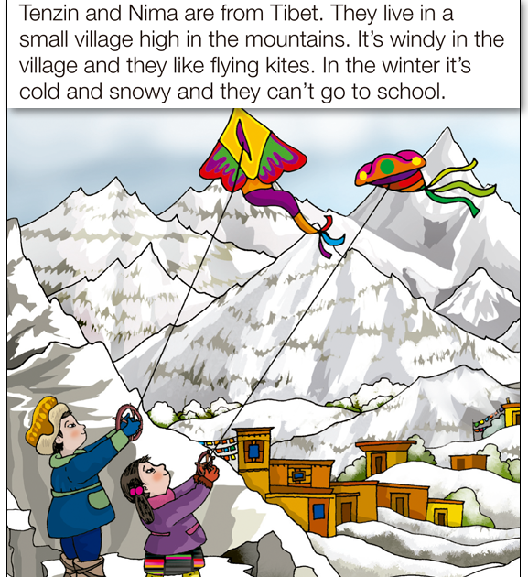

Slide 17
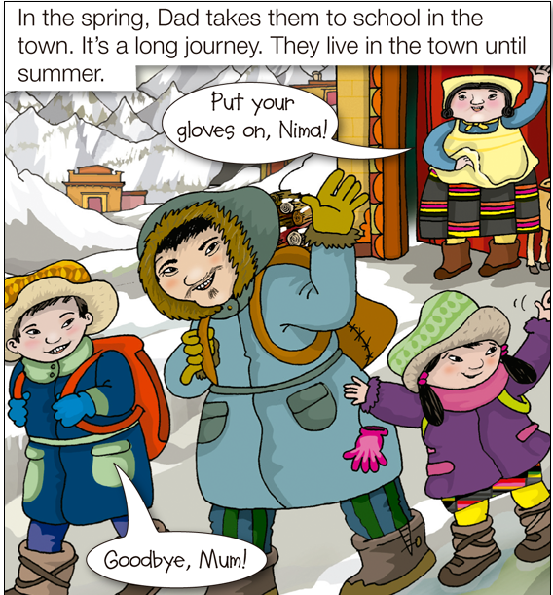

Slide 18
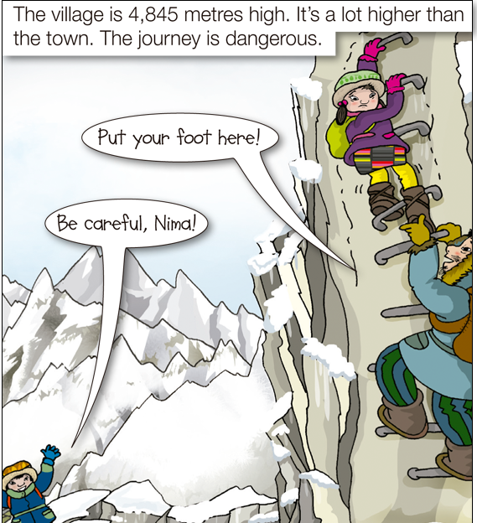

Slide 19
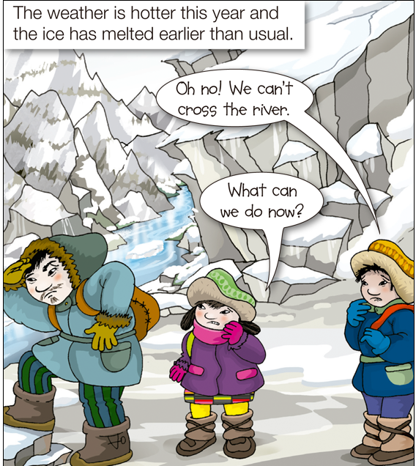

Slide 20
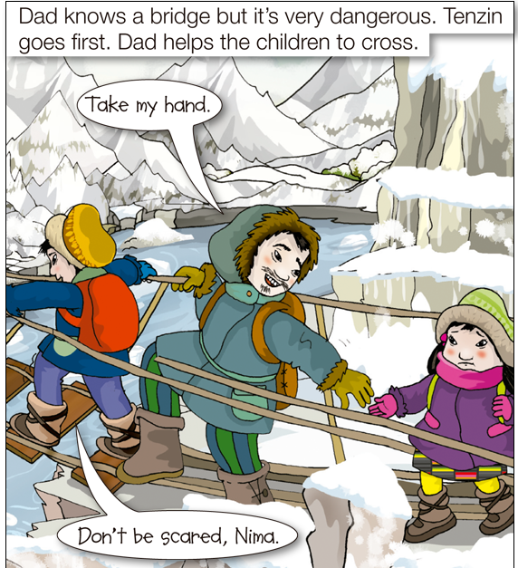

Slide 21
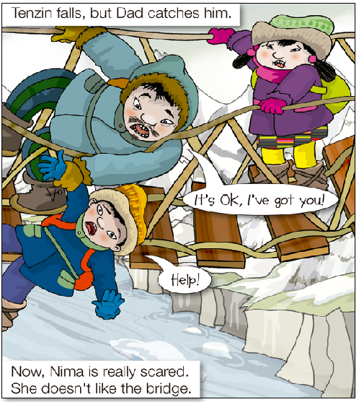

Slide 22
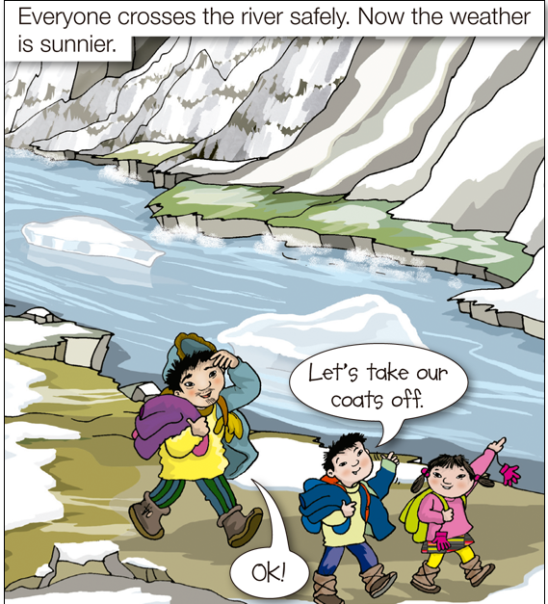

Slide 23
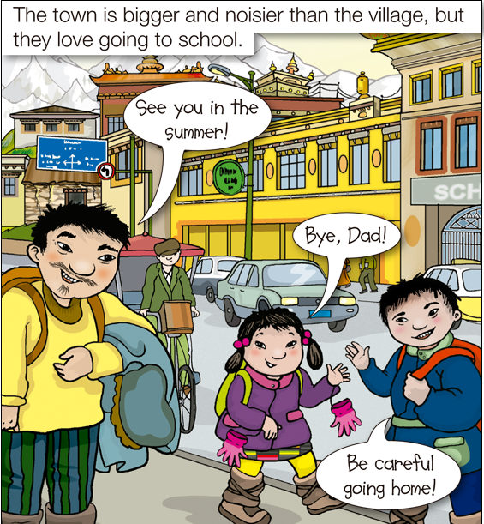

Slide 24
Sing Songs

Slide 25
letter | name | place | animal | Food/ drink | object | points

