Slide 1
Class 2

Slide 2
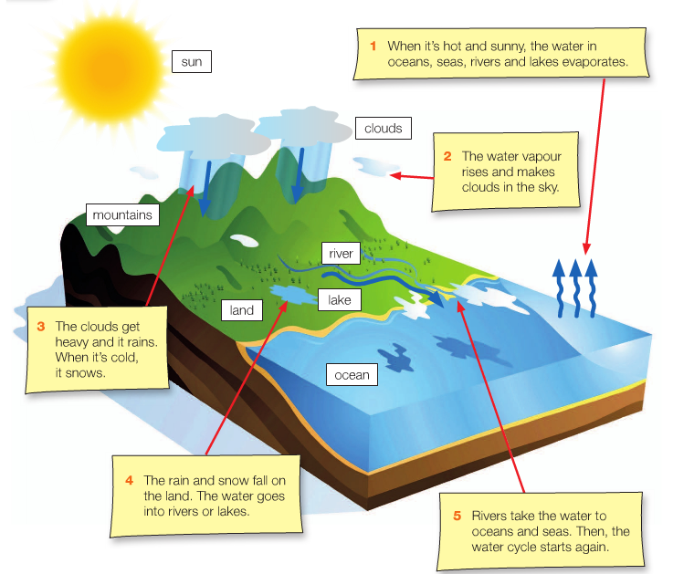

Slide 3
A long way to school
Story

Slide 4
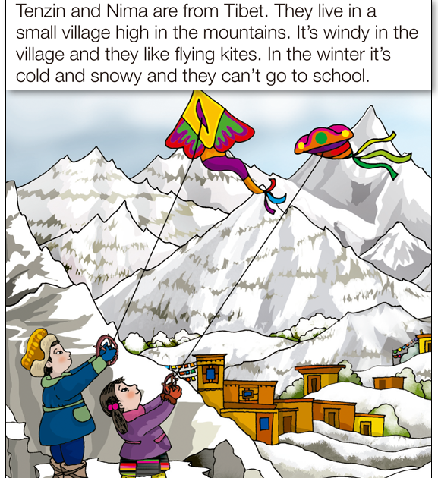

Slide 5
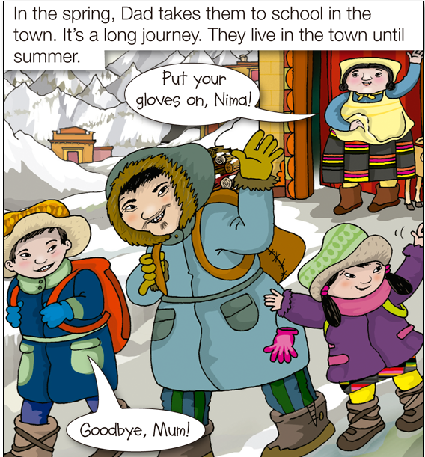

Slide 6
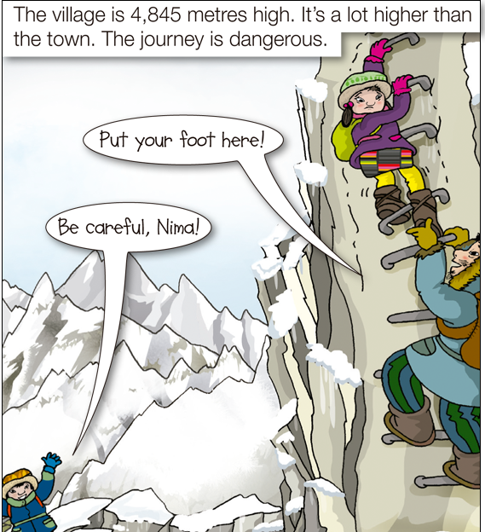

Slide 7
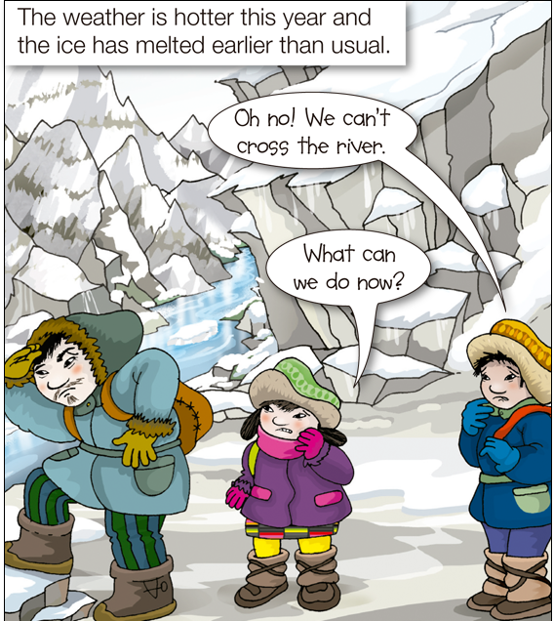

Slide 8
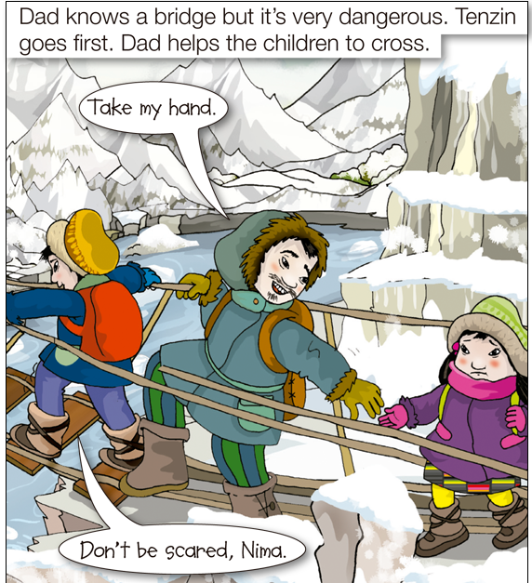

Slide 9
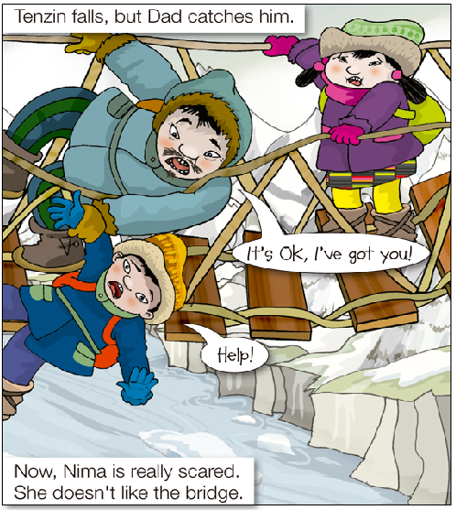

Slide 10
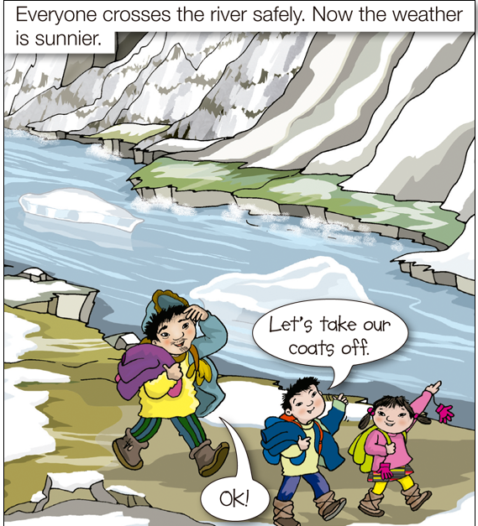

Slide 11
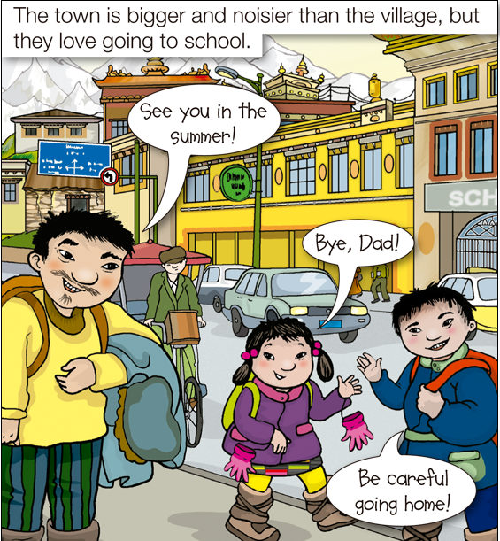

Slide 12
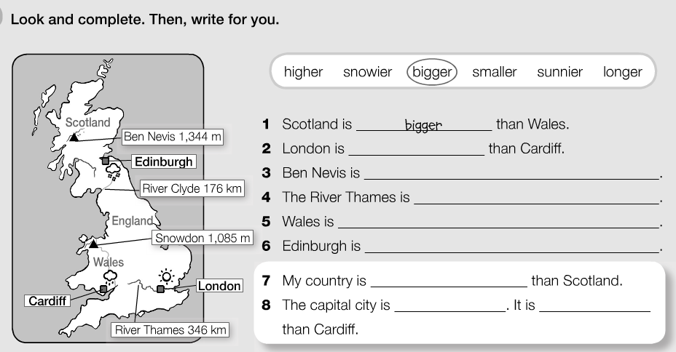

Slide 13
Sing Songs

Slide 14


Slide 15
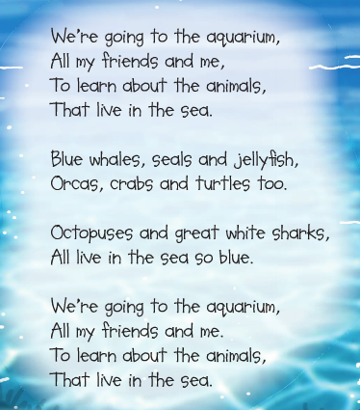

Slide 16
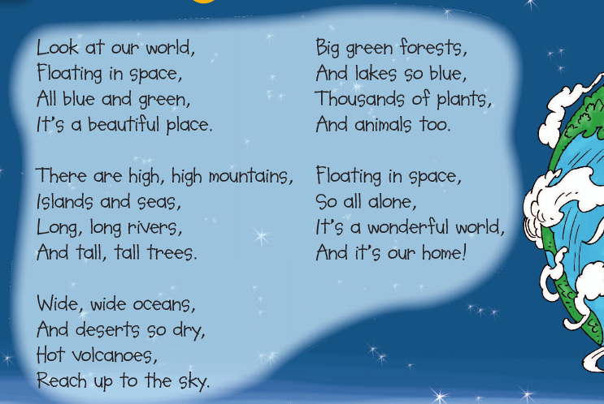

Slide 17
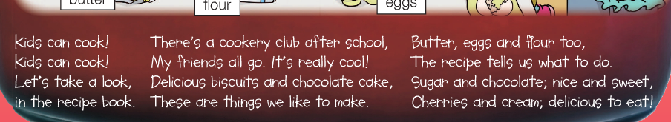

Slide 18
Intreview questions
1.What is your favourite colour/ animal/ food/ toy? 2. Why do you like being a kid? 3. One word to describe you would be _______. 4. What advice would you give your parents? 5. If you could be any animal, which one would you be and why? 6. What do you like to do for fun? 7. Tell about a funny time in your life. 8. What is your favorite thing to do? Why? 9. What is your favorite thing to do with your friends? 10. What do you love most about your sibling?

