Slide 1
The game gal
https://www.thegamegal.com/word-generator/

Slide 2
Brain teasers

Slide 3
1. A boy is walking down the road with a doctor. While the boy is the doctor’s son, the doctor is not the boy’s father. Then who is the doctor?

Slide 4
2.I am the beginning of sorrow and the end of sickness. You cannot express happiness without me yet I am in the midst of crosses. I am always in risk yet never in danger. You may find me in the sun, but I am never out of darkness.

Slide 5
3. A man wanted to encrypt his password but he needed to do it in a way so that he could remember it. He had to use seven characters consisting of letters and numbers only (no symbols like ! or <). In order to remember it, he wrote down “You force heaven to be empty.” What is his password?

Slide 6
4.Arnold Schwarzenegger has a long one. Michael J. Fox has a short one. Madonna does not use hers. Bill Clinton always uses his. The Pope never uses his. What is it?

Slide 7
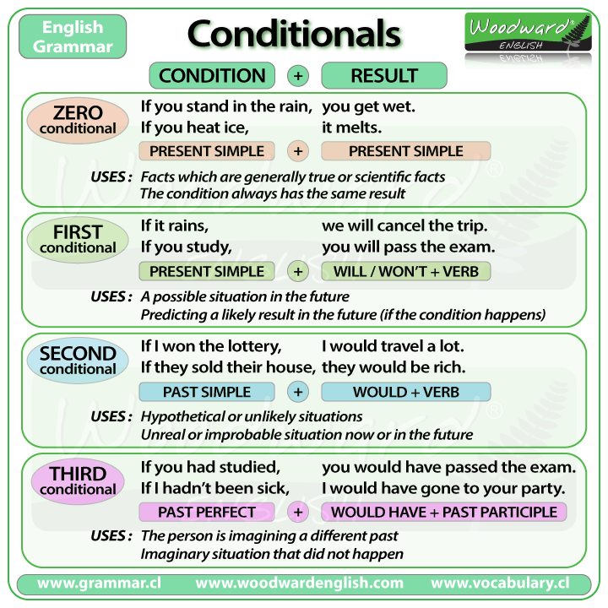

Slide 8
For Questions 1-8, complete the second sentence so that it has a similar meaning to the first sentence using the word given. Do not change the word given. You must use between two and five words.
1. I only told you because I thought you would be interested. TOLD I ................................................. you if I thought you weren't interested. 2. I won't organise the party unless you arrange the food. LONG I'll organise the party ....................................................... arrange the food.
3. I think it would be a good idea to speak to the manager first. WERE If ......................................................... speak to the manager first.
4. If you do the washing up I'll make the coffee. PROVIDED I'll make the coffee .......................................................... the washing up.
5. Your tired because you keep staying up late. WERE If ............................................................. to bed earlier, you wouldn't be so tired.
6. You never enter competitions so you'll never win anything. MIGHT If you entered competions ...................................................... something.
7. The reason I haven't got much money is because they didn't give me promotion. POOR If they had given me promotion I ............................................................... now. 8. I've been so happy since I met you. MIGHT I ................................................................ so happy if I hadn't met you.

Slide 9
1 min debate
You are an ant. Convince an anteater to not eat you.
Explain three different ways to eat an Oreo cookie.
Convince us to vote for you as president of the USA.
Explain three uses for a pencil other than for writing.
Convince us that homework is harmful to your health.
Tell us about your favorite pet and why it should win the Greatest Pet Ever award.
You are a salesperson trying to sell us the shirt you have on.

Slide 10
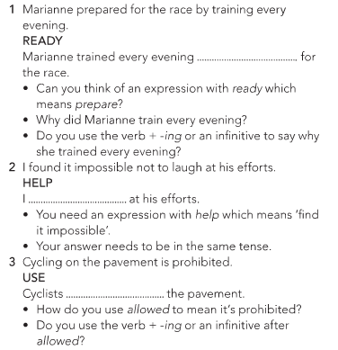
Homework

Slide 11
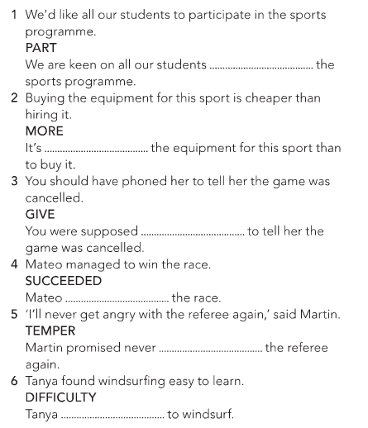

Slide 12
