Slide 1
Revision Reading part 7

Slide 2
Short conversation about travelling
Are you afraid of going abroad alone?
Could you live in another country for the rest of your life?
Describe the most interesting person you met on one of your travels.

Slide 3


Slide 4
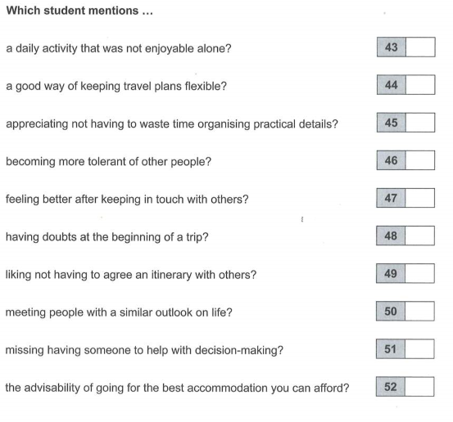
Look at the following questions

Slide 5
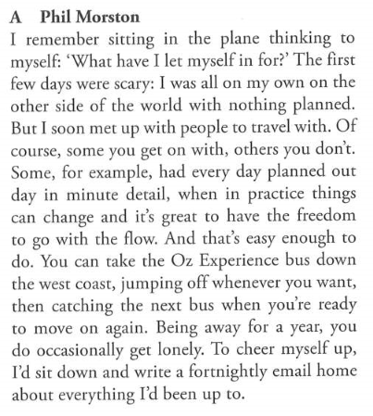

Slide 6
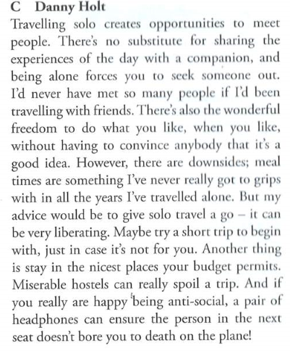

Slide 7
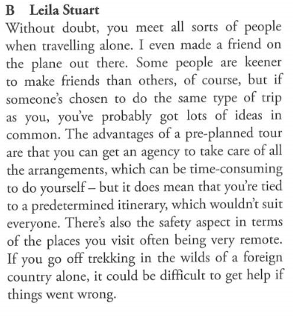

Slide 8
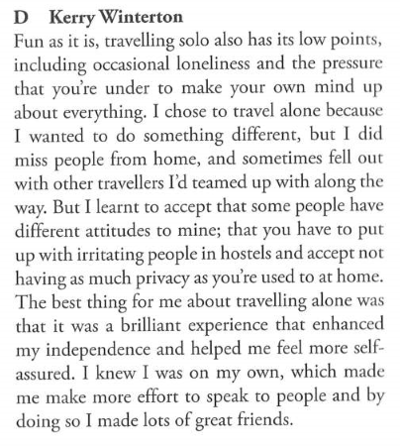

Slide 9
Homework : write an essay
Please send your essays to: freewayteachers@gmail.com
“In order to save the environment, governments should discourage overseas tourists from visiting.” Do you agree?
Write about:
1. the negative effects of tourism on the environment
2. the economic effects of tourism
3. … (your own idea)

