Slide 1
Reported speech

Slide 2
Here's how it works:
We use a 'reporting verb' like 'say' or 'tell'. If this verb is in the present tense, it's easy. We just put 'she says' and then the sentence:
Direct speech: I like ice cream.
Reported speech: She says (that) she likes ice cream.
We don't need to change the tense, though probably we do need to change the 'person' from 'I' to 'she', for example. We also may need to change words like 'my' and 'your'.

Slide 3
But, if the reporting verb is in the past tense, then usually we change the tenses in the reported speech:
Direct speech: I like ice cream.
Reported speech: She said (that) she liked ice cream.

Slide 4
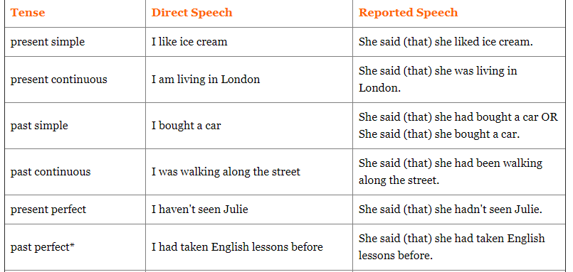

Slide 5
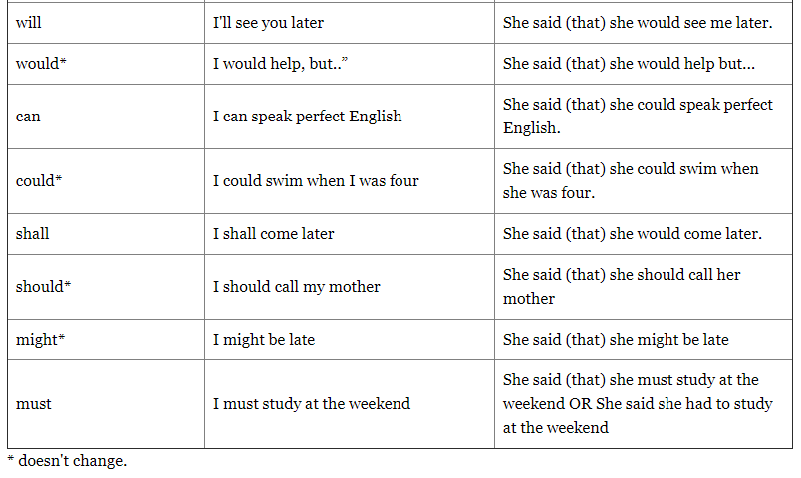

Slide 6
Reported Questions
So now you have no problem with making reported speech from positive and negative sentences. But how about questions?
Direct speech: Where do you live?
How can we make the reported speech here? In fact, it's not so different from reported statements. The tense changes are the same, and we keep the question word. The very important thing though is that, once we tell the question to someone else, it isn't a question any more. So we need to change the grammar to a normal positive sentence. A bit confusing? Maybe this example will help: Direct speech: Where do you live?
Reported speech: She asked me where I lived.
The direct question is in the present simple tense. We make a present simple question with 'do' or 'does' so I need to take that away. Then I need to change the verb to the past simple.

Slide 7
Another example:
Direct speech: Where is Julie?
Reported speech: She asked me where Julie was.
The direct question is the present simple of 'be'. We make the question form of the present simple of be by inverting (changing the position of)the subject and verb. So, we need to change them back before putting the verb into the past simple.

Slide 8
So much for 'wh' questions. But, what if you need to report a 'yes / no' question? We don't have any question words to help us. Instead, we use 'if’:
Direct speech: Do you like chocolate?
Reported speech: She asked me if I liked chocolate.
Direct Question | Reported Question
Do you love me? | He asked me if I loved him.
Have you ever been to Mexico? | She asked me if I had ever been to Mexico.
Are you living here? | She asked me if I was living here.

Slide 9
Reported Requests
There's more! What if someone asks you to do something (in a polite way)? For example:
Direct speech: Close the window, please
Or: Could you close the window please?
Or: Would you mind closing the window please?
All of these requests mean the same thing, so we don't need to report every word when we tell another person about it. We simply use 'ask me + to + infinitive':
Reported speech: She asked me to close the window.

Slide 10
Reported Orders
And finally, how about if someone doesn't ask so politely? We can call this an 'order' in English, when someone tells you very directly to do something. For example:
Direct speech: Sit down!
In fact, we make this into reported speech in the same way as a request. We just use 'tell' instead of 'ask':
Reported speech: She told me to sit down.
Direct Order | Reported Order
Go to bed! | He told the child to go to bed.
Don't worry! | He told her not to worry.
Be on time! | He told me to be on time.
Don't smoke! | He told us not to smoke.

Slide 11
Here's a table of some possible conversions:
now | then / at that time
today | yesterday / that day / Tuesday / the 27th of June
yesterday | the day before yesterday / the day before / Wednesday / the 5th of December
last night | the night before, Thursday night
last week | the week before / the previous week
tomorrow | today / the next day / the following day / Friday

Slide 12
Change the direct speech into reported speech. Choose the past simple of ‘ask’, ‘say’ or ‘tell’:
1. “Come quickly!” She _________________________________________________
2. “Did you arrive before seven?” She ______________________________________________________________
3. “How was your holiday?” She ______________________________________________________________
4. “I would have visited the hospital, if I had known you were sick” She ______________________________________________________________
5. “Don't touch!” She ______________________________________________
6. “Do you usually cook at home?” She ______________________________________________________________
7. “They had never been to Scotland until last year” She ______________________________________________________________
8. “Make sure you arrive early!” She ______________________________________________________________
9. “I should have studied harder for the exam” She ______________________________________________________________
10. “Would you mind telling me how to get to the art gallery, please?” She ______________________________________________________________

Slide 13
11. “Please don’t forget my book” She ______________________________________________________________
12. “Make sure you arrive at six!” She ______________________________________________________________
13. “Remember to study hard!” She ______________________________________________________________
14. “Where do you want to eat tonight?” She ______________________________________________________________
15. “I usually drink coffee in the mornings” She ______________________________________________________________
16. “Do you like studying English?” She ______________________________________________________________
17. “I’ll come and help you on Saturday” She ______________________________________________________________
18. “Please buy some bread on your way home” She ______________________________________________________________
19. “Please give this to John” She ______________________________________________________________
20. “Could you give me the glass on the table, please?” She ______________________________________________________________

Slide 14
Exercises
https://www.perfect-english-grammar.com/reported-speech-exercise-1.html
https://www.perfect-english-grammar.com/reported-speech-exercise-2.html
https://www.perfect-english-grammar.com/reported-speech-exercise-3.html

Slide 15
Homework
http://test-english.com/grammar-points/b1/reported-speech-indirect-speech/

