Slide 1
The game gal
https://www.thegamegal.com/word-generator/

Slide 2
Brain teasers

Slide 3
1. A boy is walking down the road with a doctor. While the boy is the doctor’s son, the doctor is not the boy’s father. Then who is the doctor?

Slide 4
2.I am the beginning of sorrow and the end of sickness. You cannot express happiness without me yet I am in the midst of crosses. I am always in risk yet never in danger. You may find me in the sun, but I am never out of darkness.

Slide 5
3. A man wanted to encrypt his password but he needed to do it in a way so that he could remember it. He had to use seven characters consisting of letters and numbers only (no symbols like ! or <). In order to remember it, he wrote down “You force heaven to be empty.” What is his password?

Slide 6
4.Arnold Schwarzenegger has a long one. Michael J. Fox has a short one. Madonna does not use hers. Bill Clinton always uses his. The Pope never uses his. What is it?

Slide 7
Gerund and infinitive

Slide 8
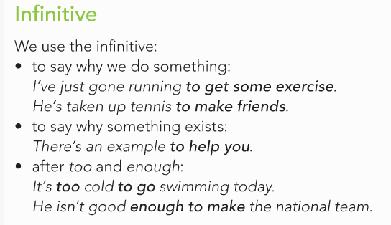

Slide 10
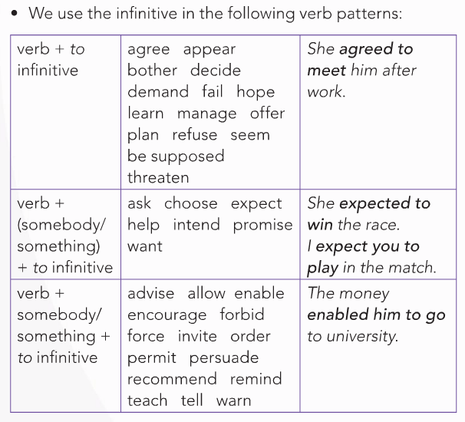

Slide 11
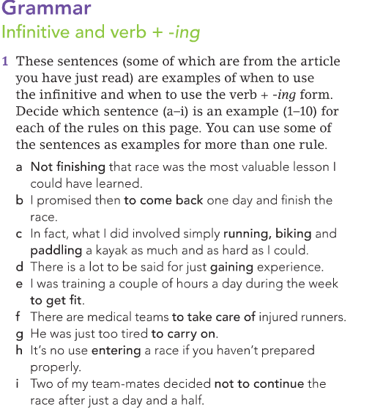

Slide 12
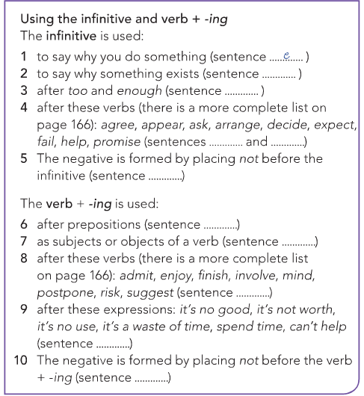

Slide 13
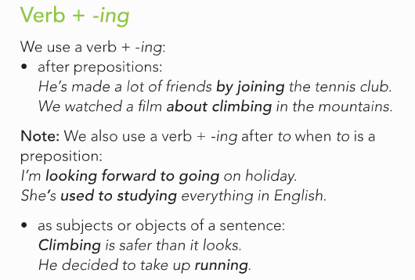

Slide 14
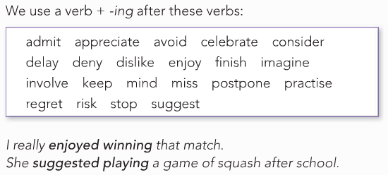

Slide 15
Homework

Slide 16
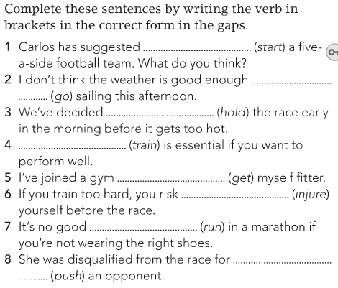

Slide 17
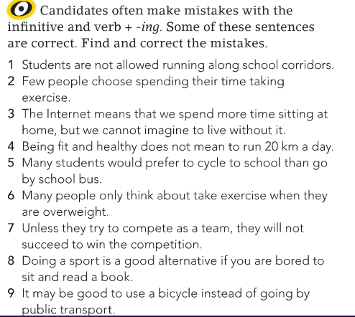

Slide 18
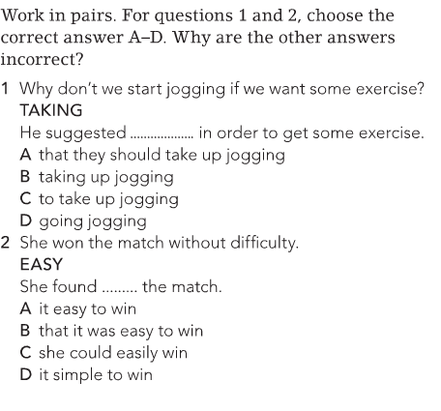

Slide 19
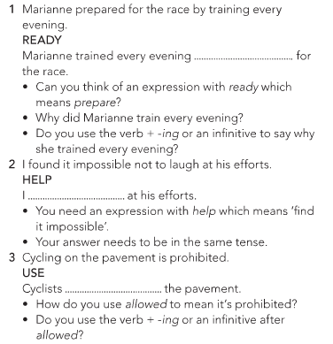

Slide 20
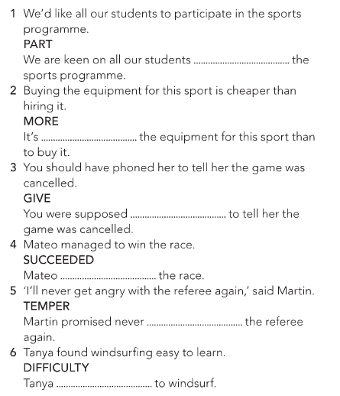

Slide 21
