Slide 1
Class 1
Story : The magic trick
Grammar: Can/ Can´t

Slide 19
´´Treasure´´ hunt
Find someting:
Blue
Yellow
That starts with the letter:
P
B
G
Round
Sweet

Slide 20
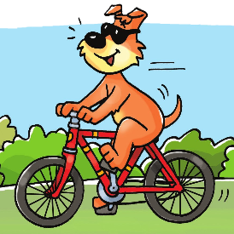

Slide 25
Class 2
Vocabulary revision
Listen to the story with Beep and Roby

Slide 44
Draw your colleagues at the park + one activity from the vocabulary

Slide 57
Songs

Slide 58
