Slide 1
Unit 8: Adventure Island
Class 1: new vocabulary
new song
writing exercise

Slide 2
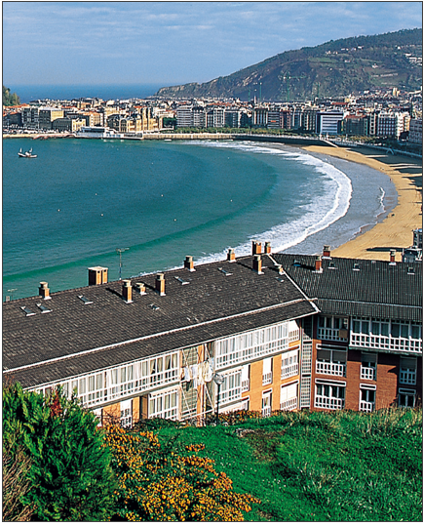

Slide 3
BAY

Slide 4
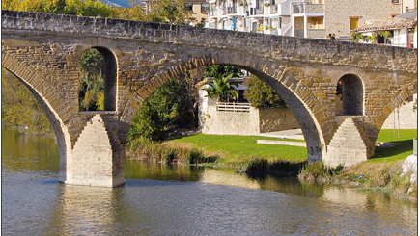

Slide 5
BRIDGE

Slide 6
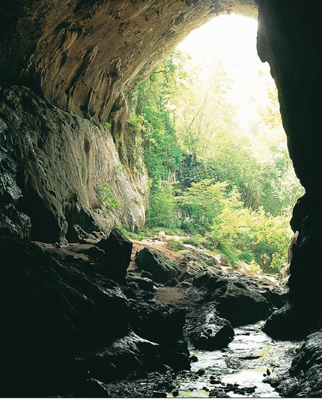

Slide 7
CAVE

Slide 8
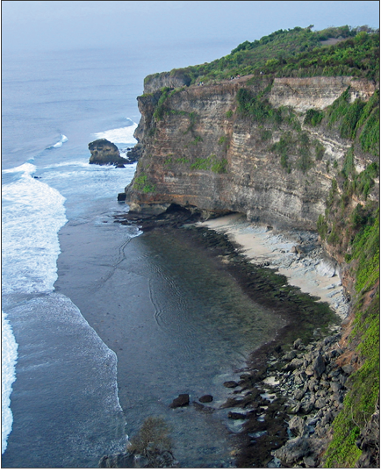

Slide 9
CLIFF

Slide 10
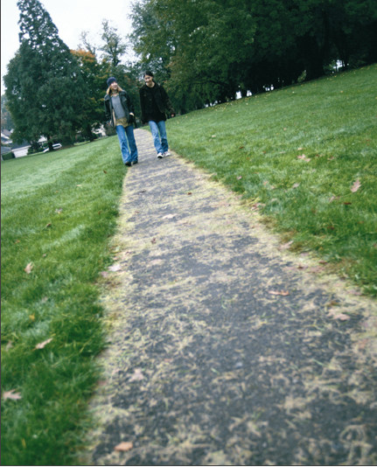

Slide 11
PATH

Slide 12
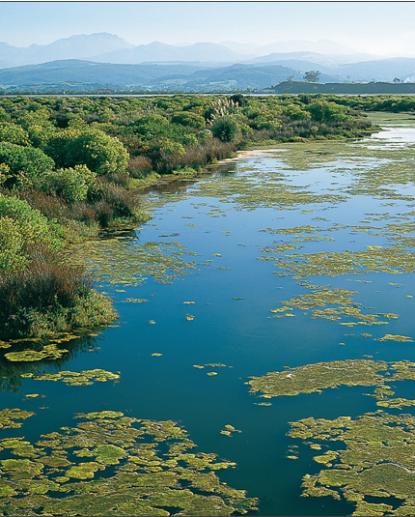

Slide 13
SWAMP

Slide 14
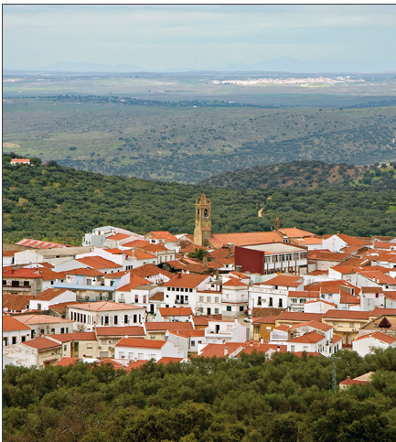

Slide 15
TOWN

Slide 16
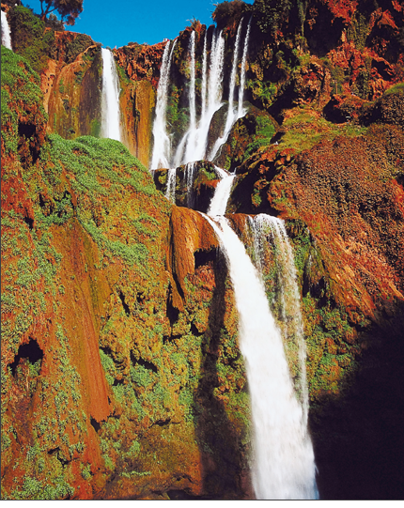

Slide 17
WATERFALL

Slide 18
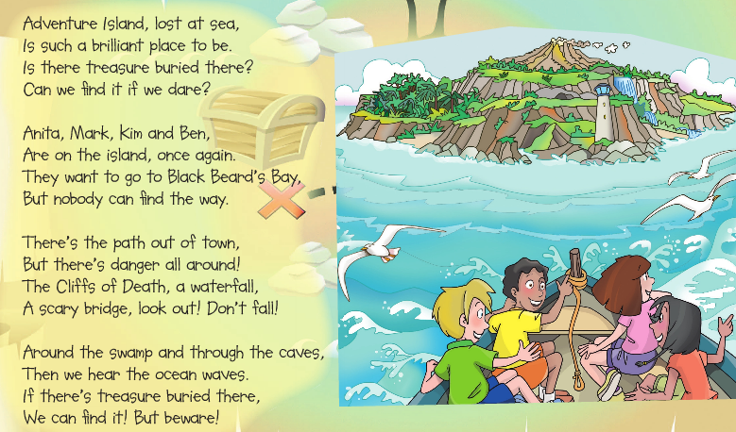

Slide 19
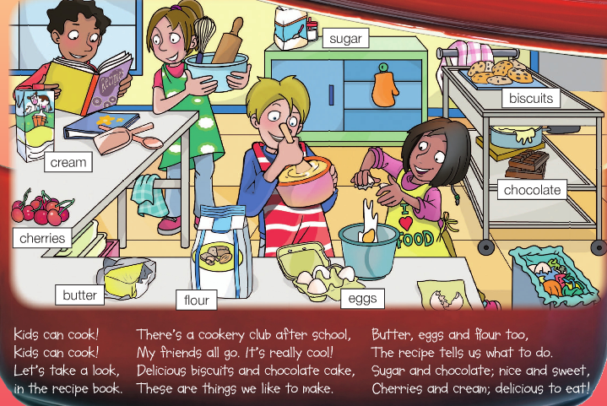

Slide 20
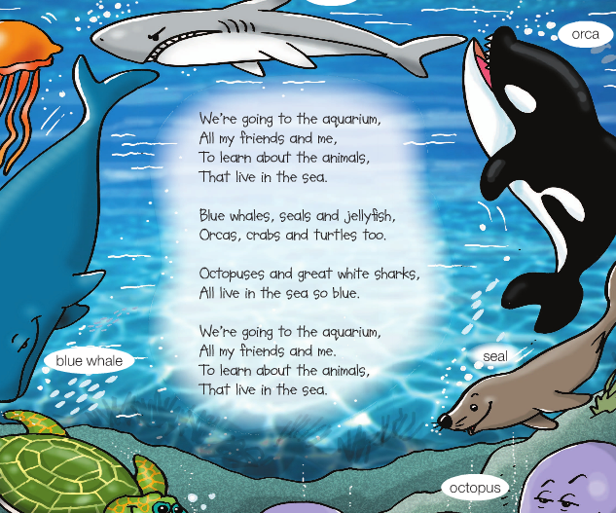

Slide 21
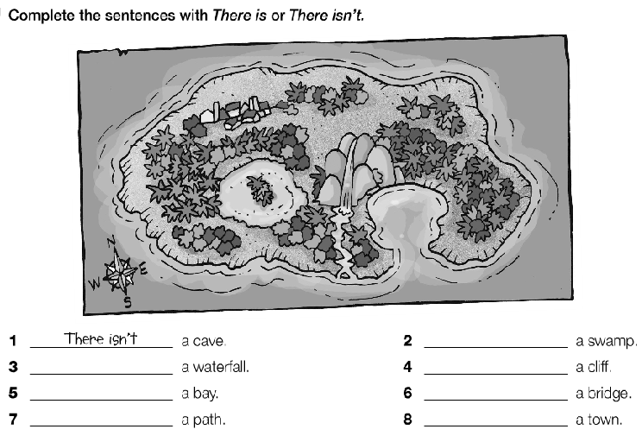

Slide 22
Class 2:
Listen to the first two parts of the story
Spelling

Slide 23
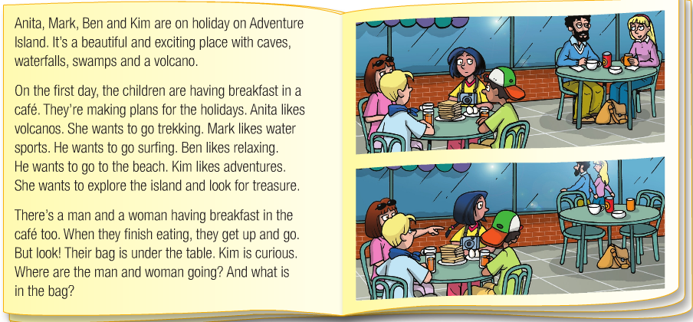

Slide 24
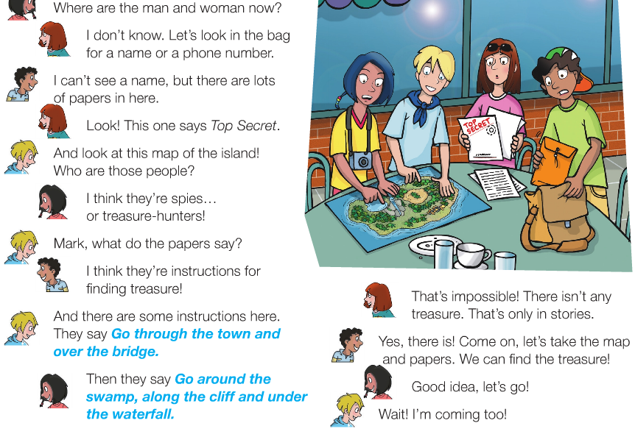

Slide 25
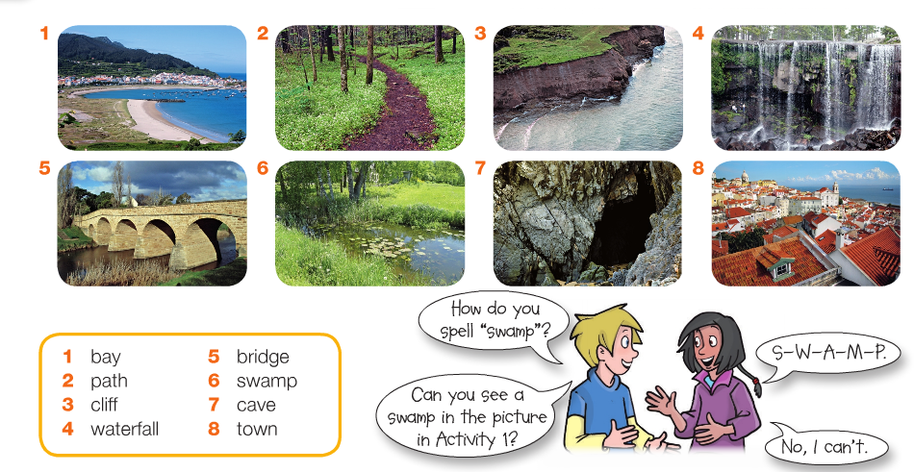

Slide 26
