Slide 1
Class 1: revision: animals and food
Revise animals
Revise food vocabulary
Draw an animal farm and the favourite food of each animal.

Slide 4
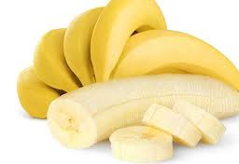

Slide 16
Class 2
Revise clothes vocabulary
Revise: free time and activity vocabulary
Draw a park with 3 friends and show what they are wearing

Slide 43
