Slide 1
Class 1
Opposites
Songs
Categories

Slide 2
https://www.baamboozle.com/game/84361

Slide 3
Find something in the house :
Big and small
Delicious and horrible
Heavy and Light
Beautiful and ugly (toys)
Black and white
Clothes for hot and cold

Slide 4
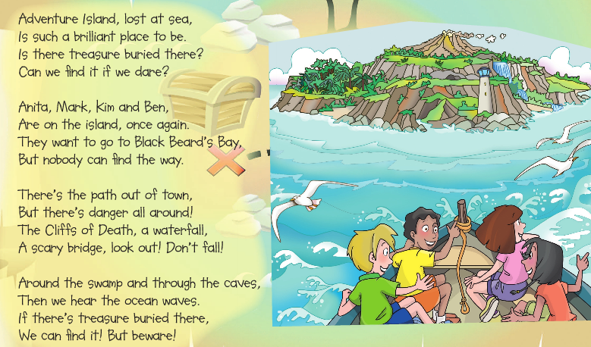

Slide 5


Slide 6
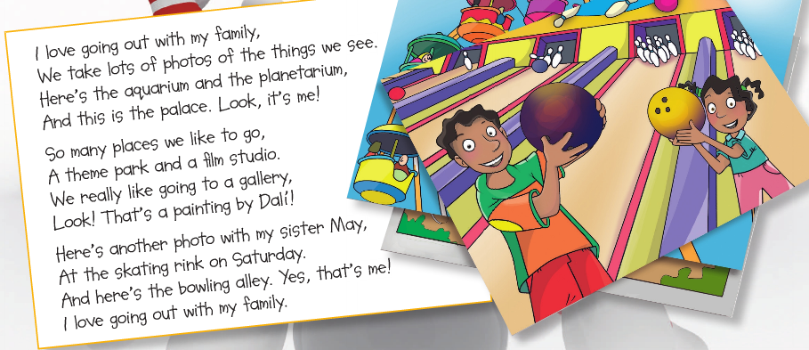

Slide 7
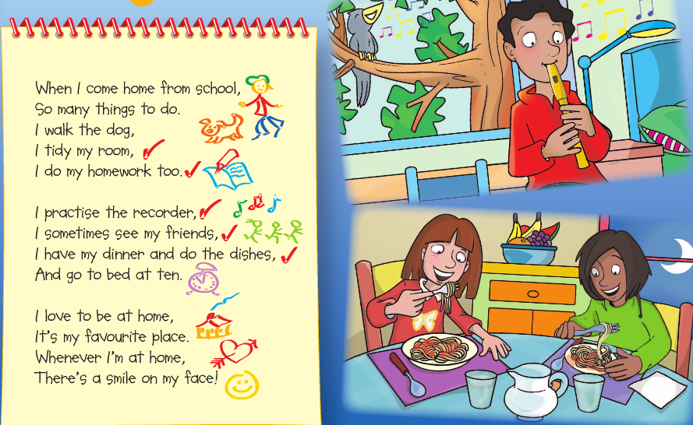

Slide 8
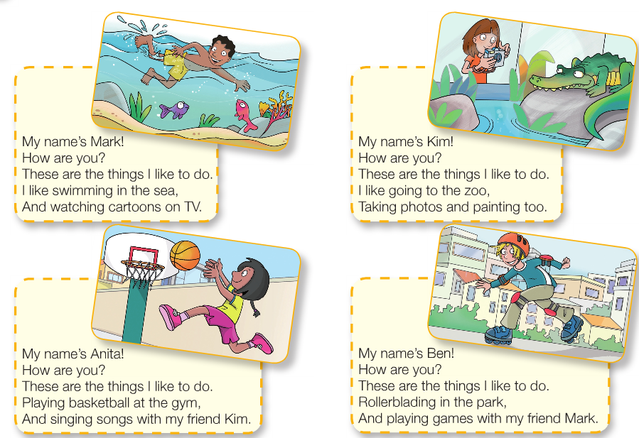

Slide 9
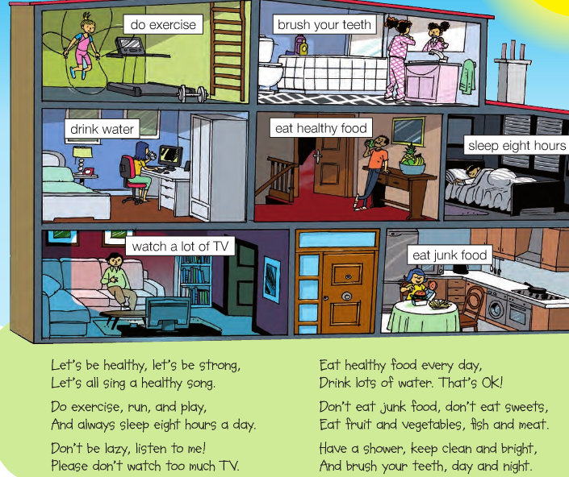

Slide 10
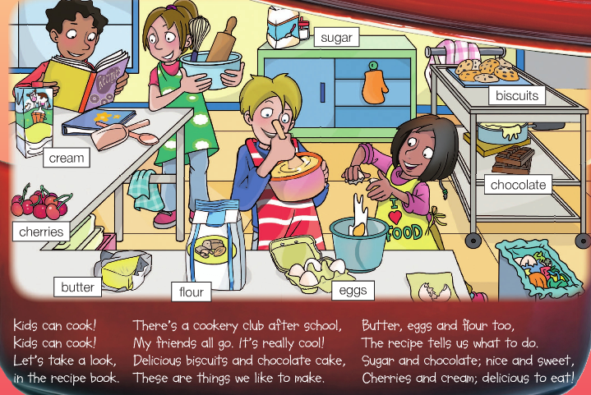

Slide 11
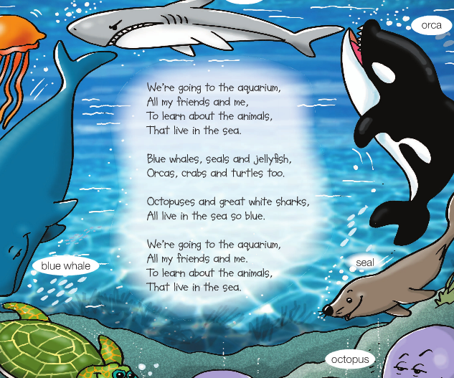

Slide 12
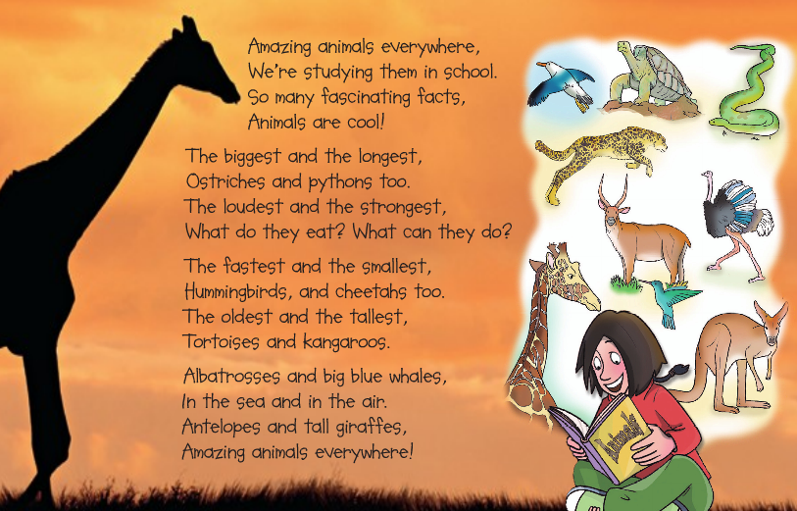

Slide 13
Categories
letter | name | place | animal | Food/ drink | object | points

Slide 14
Class 2

Slide 15
Draw a beatufil place together

Slide 16
Songs:
https://www.youtube.com/watch?v=bfhzSNW0NmE

Slide 17
Treasure Hunt in the house

Slide 18
Guess what happens next
https://www.youtube.com/watch?v=GwNIAGBWPkE

Slide 19
Happy summer!!!

