Slide 1
Phrasal verbs with get

Slide 2
There are around 10,000 phrasal verbs in the English language and they are important because:
1) English speakers tend to use the phrasal verb rather than the Latin based equivalent (e.g. give out /distribute, put up with/ tolerate etc) and so they are high frequency.
2) Understanding phrasal verbs therefore is very important but often it is difficult to understand the meaning of a phrasal verb from their individual components e.g. put up with.

Slide 3
1st activity: reading
You are going to read a dialogue between two actors who are working on a film together and are having a chat about working on their latest film.

Slide 4
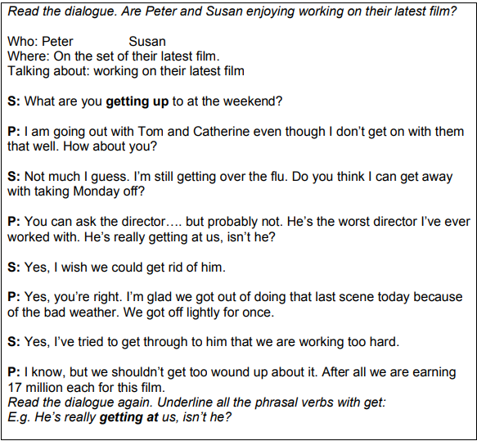

Slide 5
Are Peter and Susan enjoying working on their latest film? Why?
Underline all the phrasal verbs in the text

Slide 6
Match the words: be successful in something 2) Avoid something you don’t want to do 3) Get angry about something 4) recover from 5) To experience less suffering than expected 6) Successfully explain something 7) Do 8) have a good relationship 9) criticise someone repeatedly 10) Remove/throw away something unwanted | A. Get up to B. get on with C. get over (st,so) D. get away with (st) E. get at (so) F. get rid of (st,so) G. get out of (doing st) H. get off lightly I. get through to (so) J. get wound up (about st)

Slide 7
Answers: A – 7, B –8, C – 4, D – 1, E - 9, F – 10, G – 2, H – 5, I – 6, J – 3

Slide 8
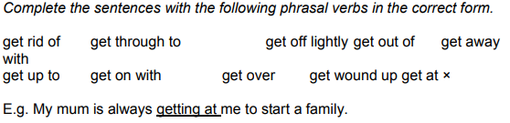

Slide 9
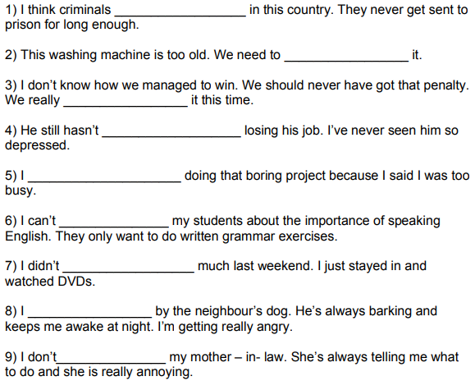

Slide 10
Answers
1) get off lightly
2) get rid of
3) get away with
4) got over
5) get out of
6) get through
7) get up to
8) get wound up
9) get on with

Slide 11
Written conversation exercise:
write down:
1) the names of two people (students in the class, or famous people).
2) the place where these people are having the conversation
3) the topic they are talking about
Ex:
1)Angelina Jolie, Homer Simpson , 2) church , 3) speaking about education
A:
B:
A:
B:

Slide 12
Speaking exercise
Discuss the following questions:
1) What lies have you told to get out of doing something?
2) Who gets at you? What about?
3) Tell about how you got over a disappointment
4) Is there anyone who you find it difficult to get through to? What’s the problem?
5) Is there anyone you don’t get on with at work/school/university?

