Slide 1

Passive
In the real word

Slide 2
First some idioms
with pictures

Slide 3
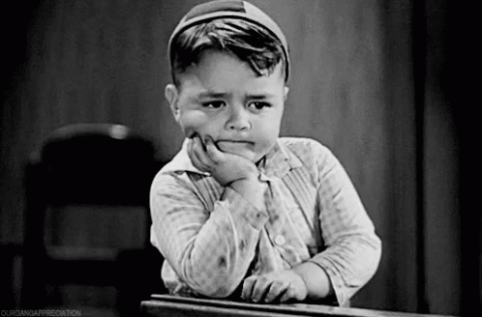
Which idioms are represented in these pictures?

Slide 4

a feeling of great sadness, especially when someone you love dies or does not love you

Slide 5
The activity of looking at goods displayed in shop windows, especially without intending to buy anything

Slide 6

put on (one's) dancing shoes To be ready to dance, as at a party or other celebratory event

Slide 7
wait a moment

Slide 8

an area in your range of vision that you cannot see properly but which you really should be able to see. For example, when you are driving a car

Slide 9
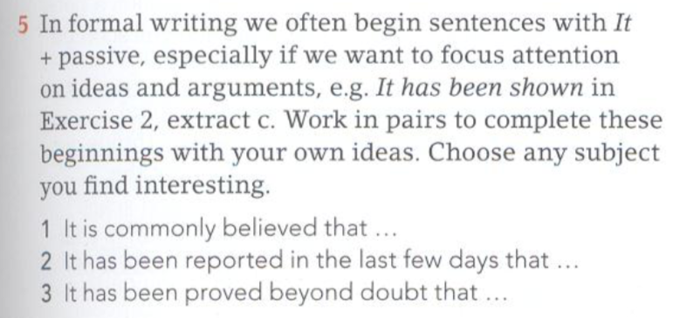
The homework was done by whom?

Slide 10
When do we use it?
Correct use of the Passive is key to success if you have to write about a process. What can you remember about the passive?
Why do we use it?
What is the form?

Slide 11
How we make the passive, a review
Subject
Object
The dog bit the man
The man was bitten by the dog
Agent (the person who does the action)
Subject

Slide 12
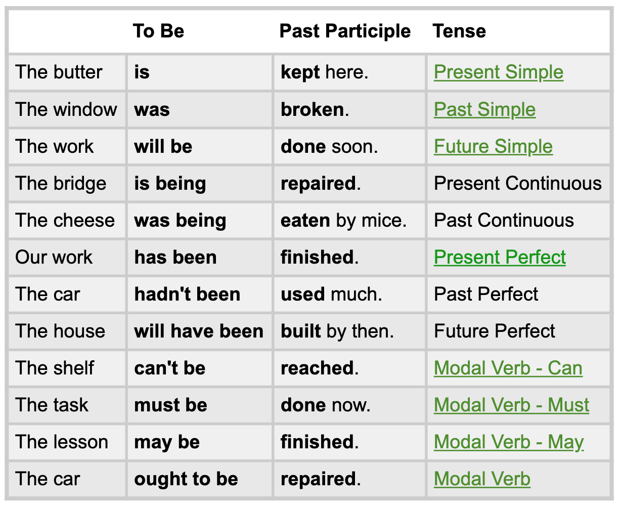

Slide 13
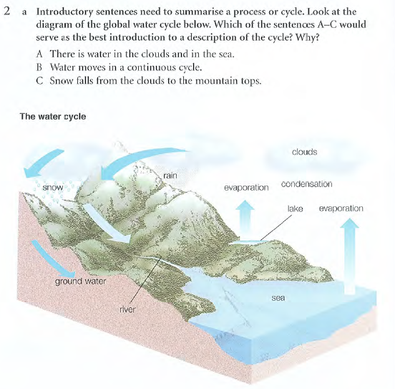

Slide 14
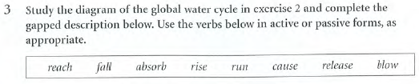
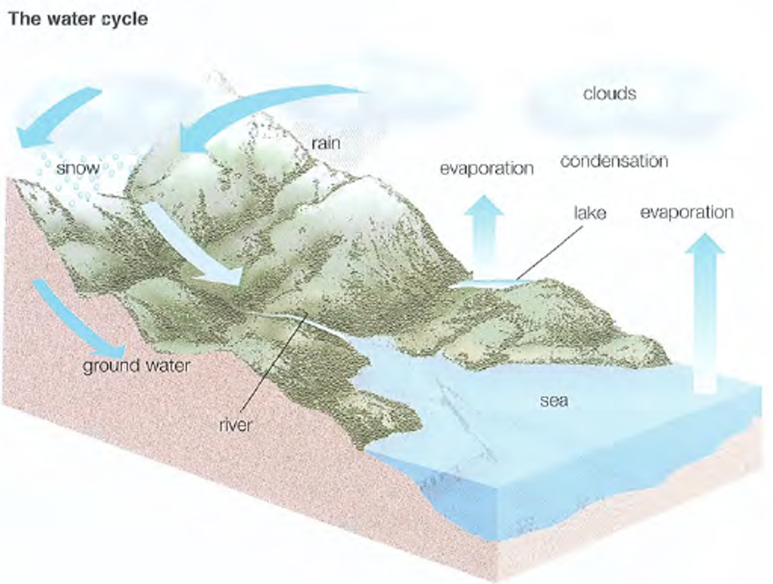
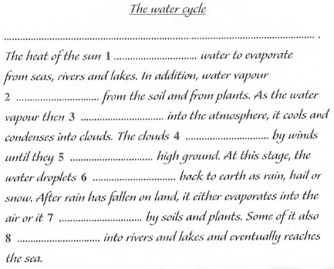
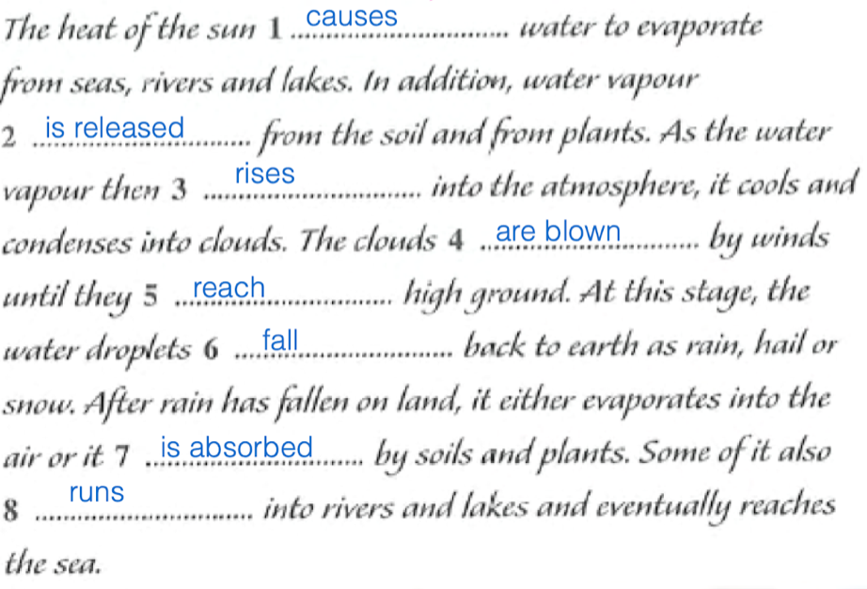
What tenses are used in the description? Why?
True or False? When describing a process, all verbs should be in the passive form?
What sequencing words and phrases are used?

Slide 15
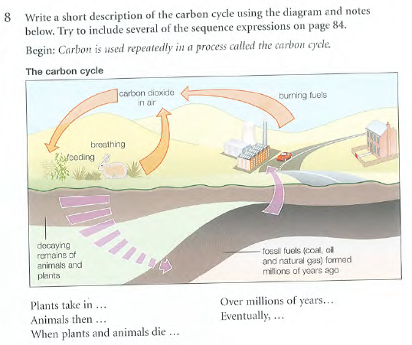

Slide 16

Homework from Beatriz

Slide 17
