Slide 1
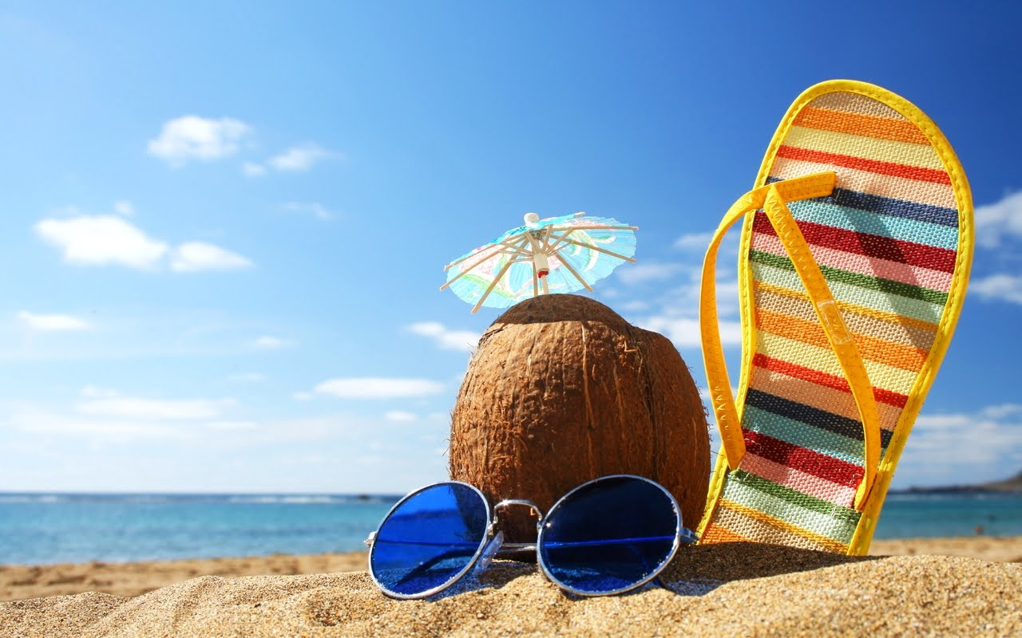
Holiday Destinations

Slide 2
Expressions
I’d like to go | I wouldn’t like to go | I wouldn’t mind
Right up my street My dream destination It’s on my list … really floats my boat | Not my cup of tea I don’t see the appeal of… It just doesn’t do it for me. …isn’t really my thing … don’t/doesn’t really float my boat … are a big no-no for me. | Why not? Go on then, I’ll give it a go. I’ll try anything once!

Slide 3
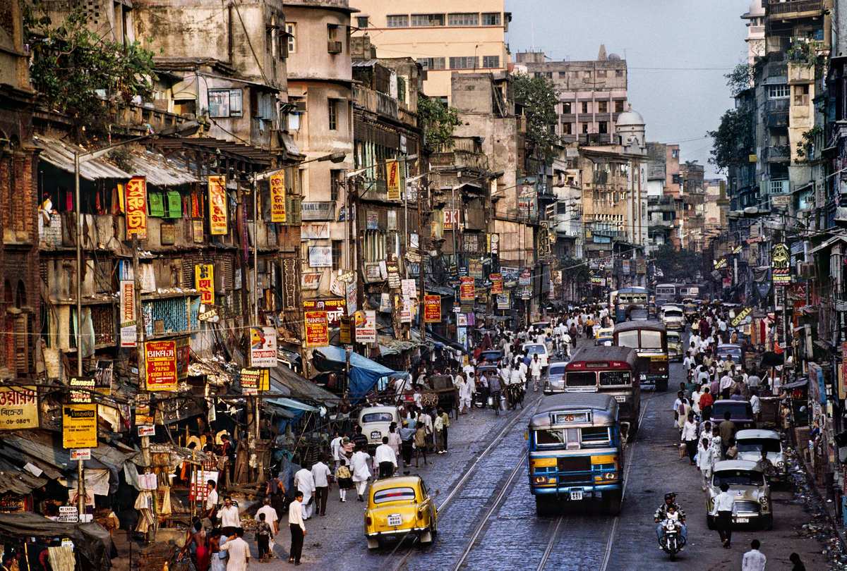
India

Slide 4
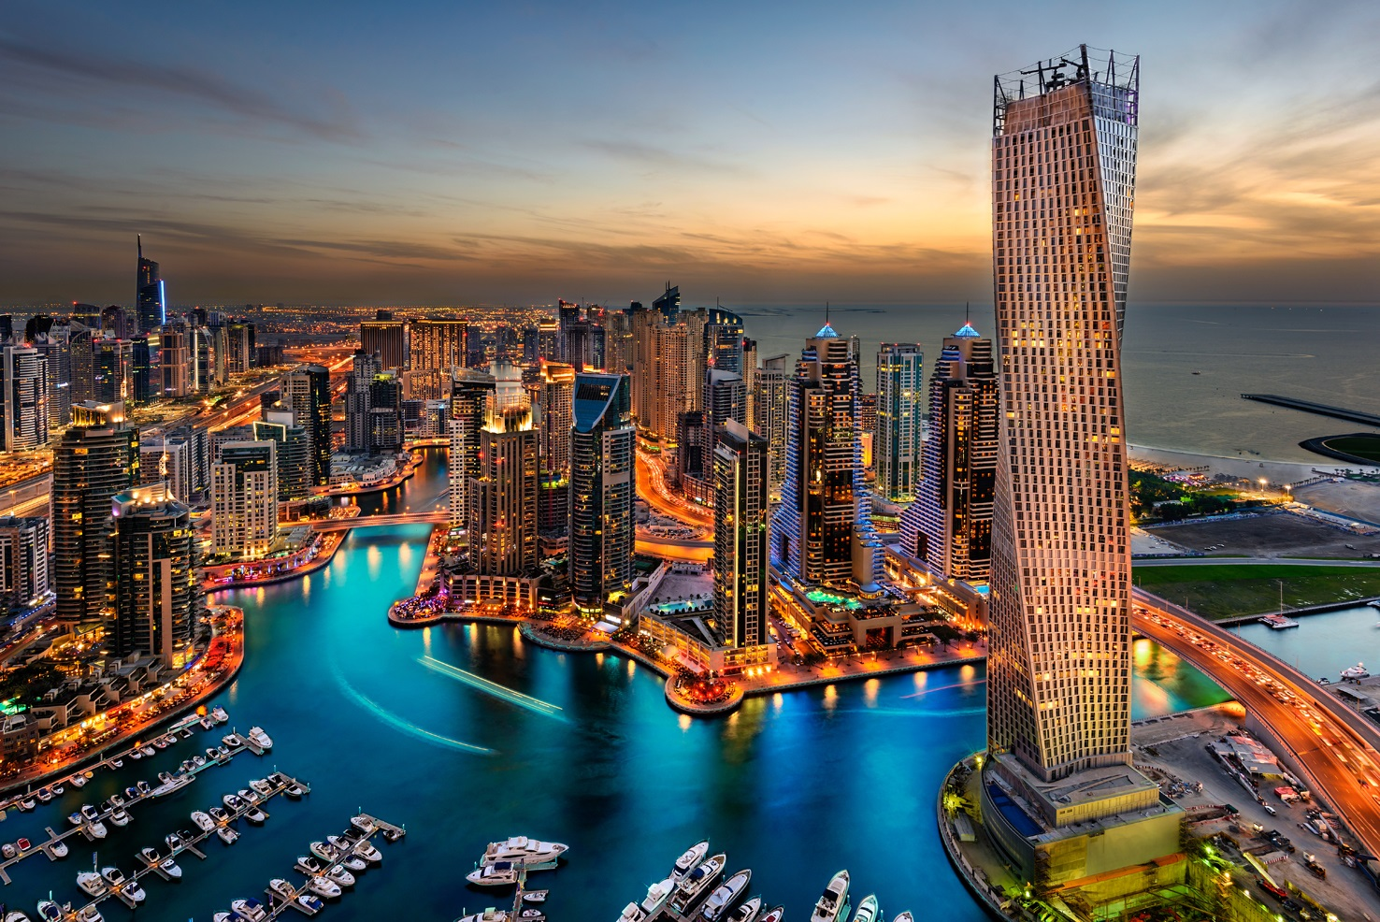
Dubai

Slide 5
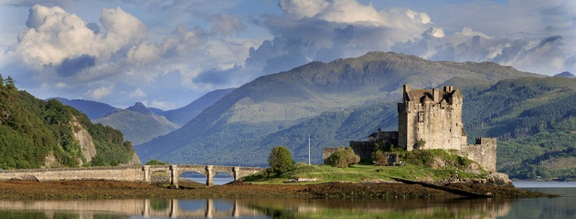
Scotland

Slide 6
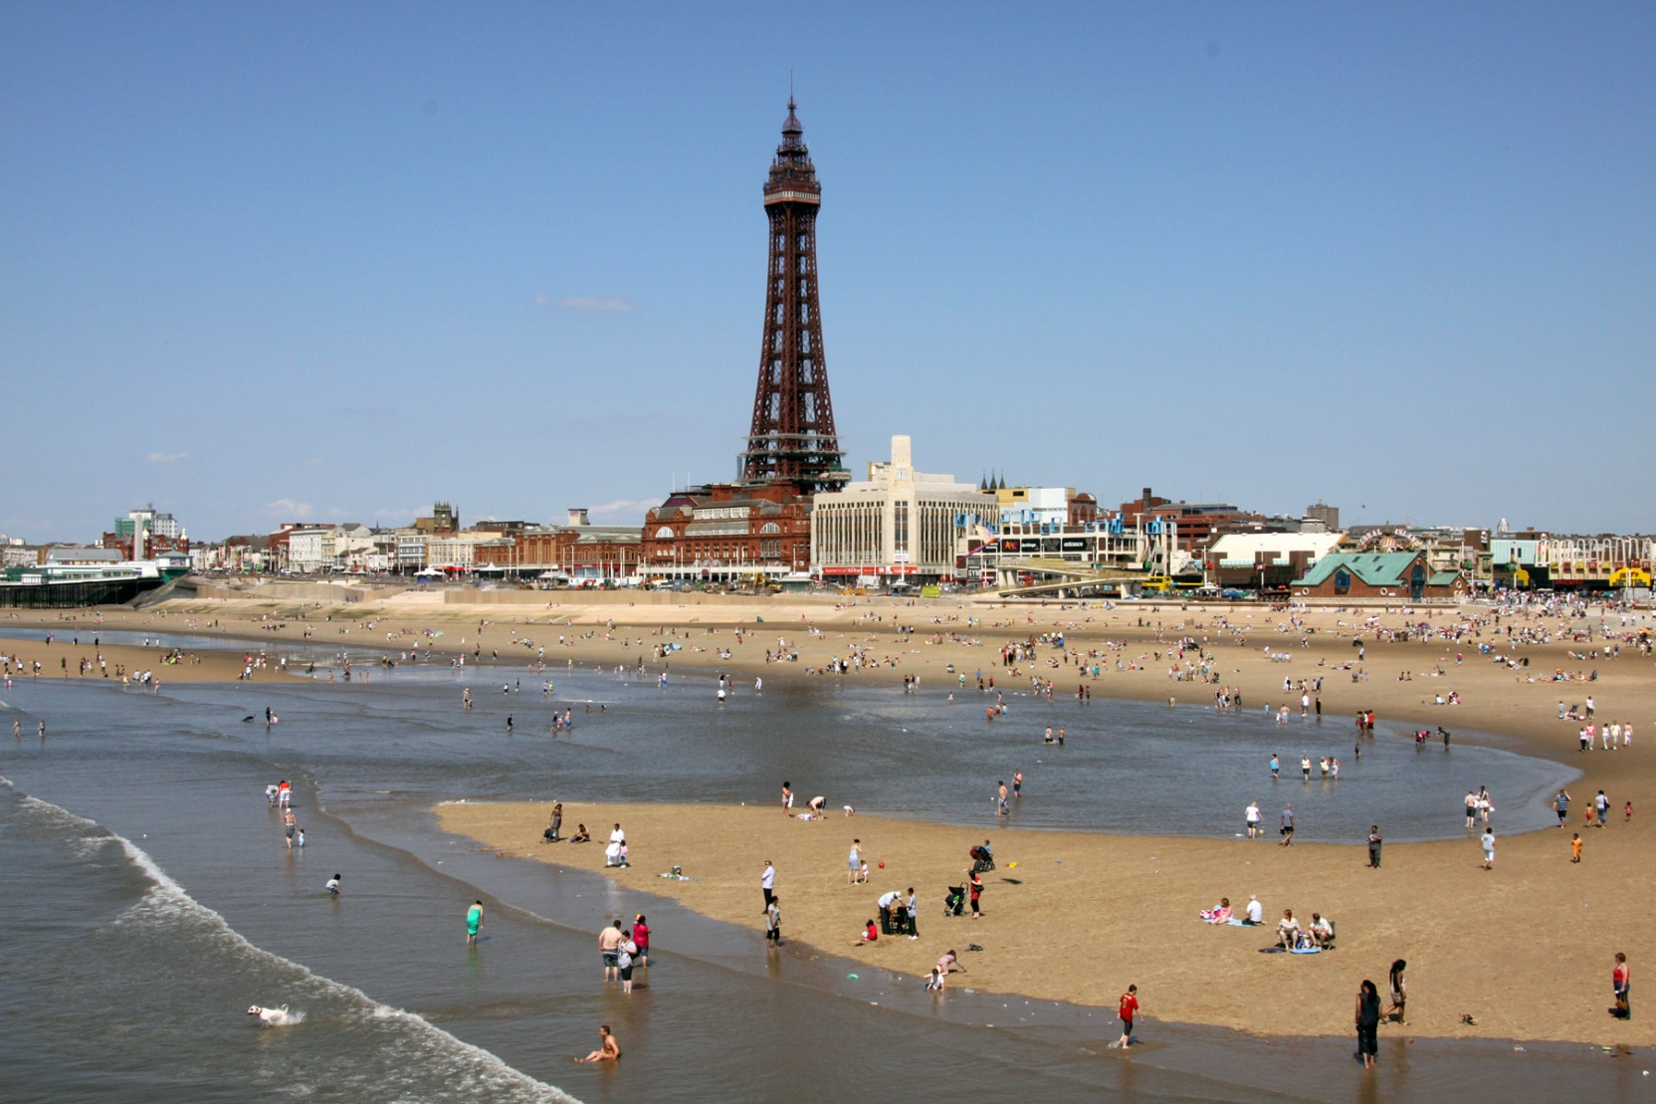
Blackpool

Slide 7
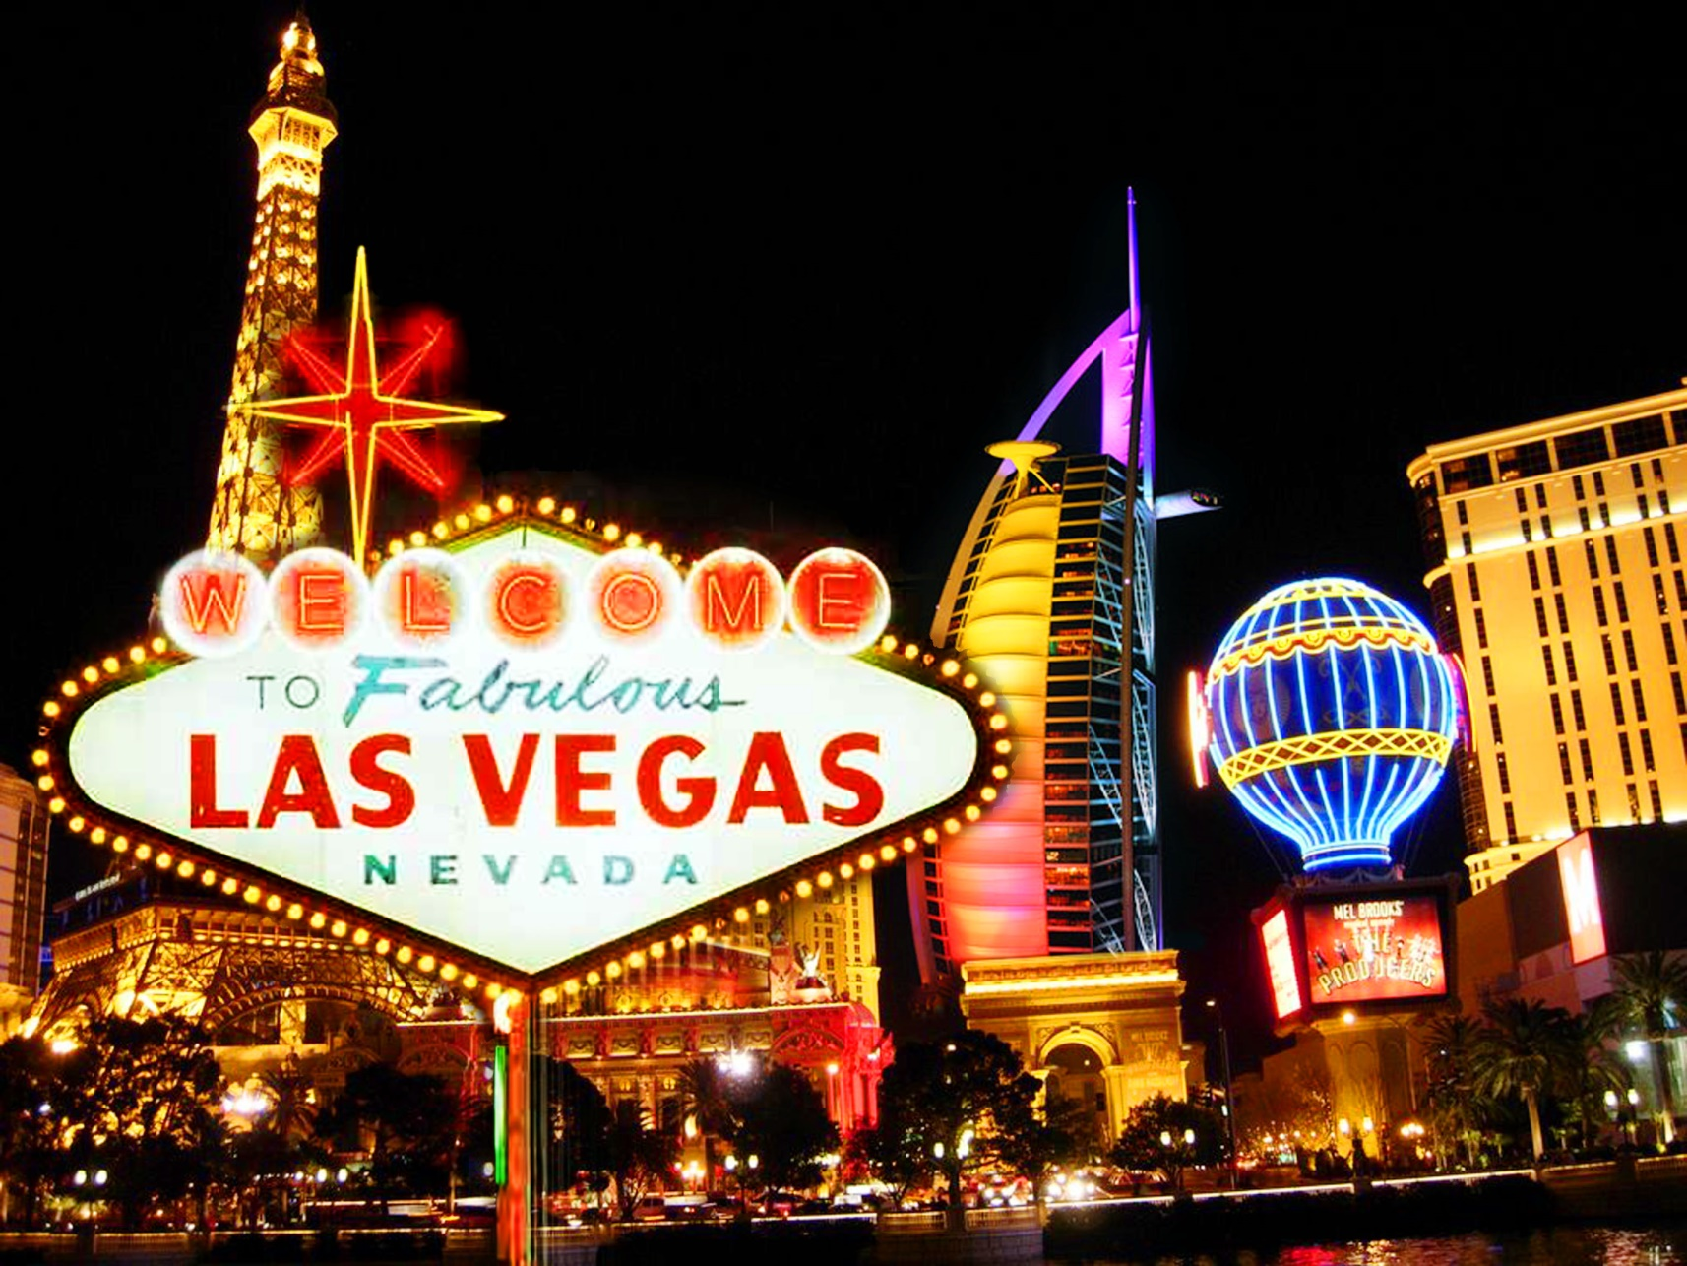
Las Vegas

Slide 8
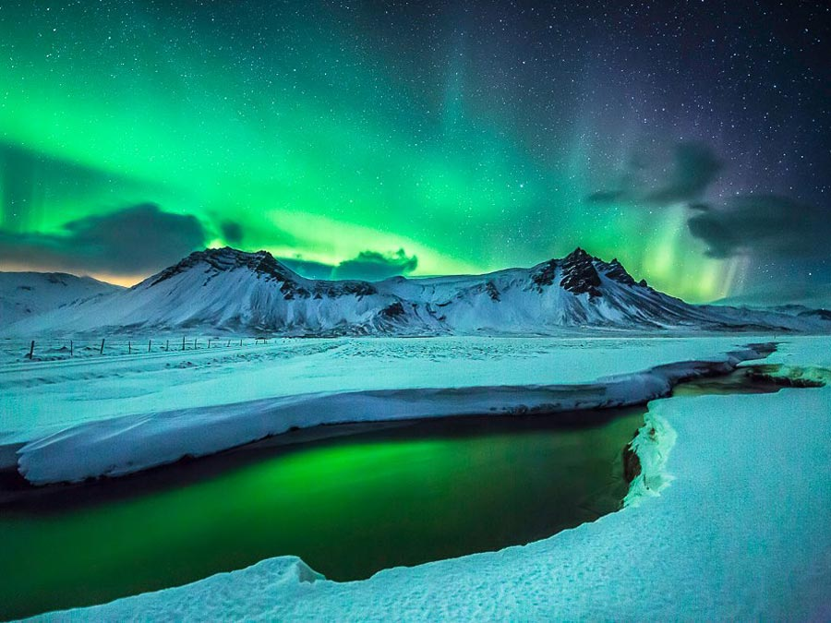
Iceland

Slide 9
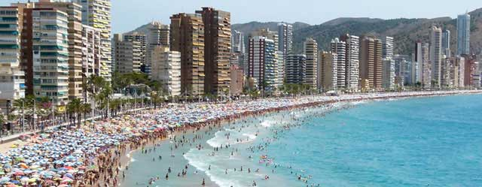
Benidorm

