Slide 1
Writing
Review
Huw Owen

Slide 2
WARMER
All my friends and family absolutely RAVED ABOUT________, but honestly IT WASN’T MY CUP OF TEA.
________ is one of the most NAIL-BITING films I've seen in a long time. I cannot recommend it enough.
You simple have to go to________ the food is SCRUMPTIOUS.
______ has to be one of the best book I've ever read. It was a WHITE-KNUCKLE RIDE from beginning to end.

Slide 3
Speaking
Do you ever read a review before choosing a film/TV program/book/game? why/why not
What is the purpose of a review?
Whose reviews do you trust most: from friends, review websites or experts? Why?

Slide 4
Language
Decide which of the adjectives in the box below are used to praise, and which to criticise.
Then add an adverb to intensify each adjective.
Example: action packed – to praise, incredibly action-packed
action-packed brutal far-fetched gloomy gripping moving powerful predictable pretentious slow-moving spectacular stylish subtle unconvincing uninspired witty

Slide 5
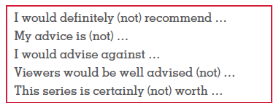
TASK: Note down three films or TV series you would recommend, and three you wouldn’t. Tell your partner about them using the expressions in the box plus the to-infinitive or –ing. Give reasons using phrases from Exercise 1. Example: I would definitely recommend watching Mr. Bean. It is totally convincing and extremely powerful.

Slide 6
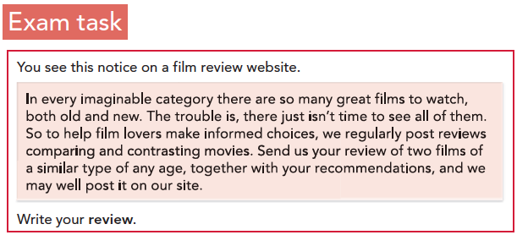
TASK: Look at the exam task and answer the questions. What do you have to review? Who are you writing for and why do they want a review? What must you do in your review?

Slide 7
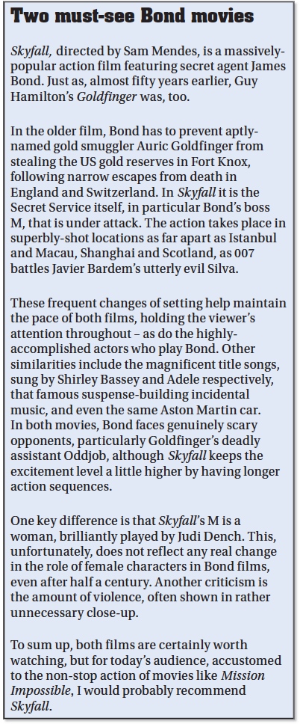
TASK: Quickly read the model review and answer the questions. 1 Did the reviewer enjoy watching a) Goldfinger b) Skyfall? 2 Which does the reviewer particularly recommend?

Slide 8
TASK: Answer the questions about the model review. 1 In which paragraph(s) does the writer: • give a synopsis of each film? • make recommendations? • give a little background information? • mention characters in both films? • aim to catch the reader’s attention? • criticise both films? • praise both films? 2 According to the reviewer, what similarities are there between the films? What contrasts are there? 3 What examples are there of adverb/adjective collocations? 4 What style is the review written in? 5 What expressions give the reviewer’s own opinions? 6 Does the review make you want to watch either of the films (again)?

Slide 9
A review
Register: Informal/neutral
Use: all your colourful vocabulary: Phrasal verbs/idioms/impressive collocations.
Forms and conventions: Title: for films/books/restaurants use the name/title or if think up an imaginative title using an idiom/expression.

Slide 10
Planning, the six steps
Read task, underline content points.
Divide content points into paragraphs: Intro, décor, ambiance, service, food, recommendation.
WHAT do you want to say? Add your notes to each paragraph in simple form.
HOW are you going to say that? Brainstorm advanced grammar and vocabulary for each note.
Forms and conventions: Title paragraph titles, fixed introduction.
Write! Remember word limit is: 220-260

Slide 11
Introduction
Personal anecdote to grab attention. Introduce name of book/film, restaurant + location, course, TV show etc.
Seldom do I find the time to…, however when I do take time out of my hectic schedule, I like nothing more than…
Being a bit of a film buff/book worm/foody, the news that … had opened a new restaurant/released a new film/book had me itching to try/see/read it. So last week I popped down with a friend to check it out.
Having never seen/read/tried… before I approached … with a sense of trepidation, not knowing what to expect. Soon however, all my fears were allayed.

Slide 12
Grammar check list
Have you included?
An inversion (not only/no sooner/seldom)
An inverted conditional (Were we to…)
A participle clause (Being…/Having gone…)
A double comparative (The more we… the more)
A cleft sentence (What is most crucial is…)
Idioms (The new Star Wars films are a complete sell out)
Phrasal verbs (They could have cut out the last scene)

Slide 13
Language and grammar for reviews

Slide 14
Introduction
As with an article you need an exciting start to catch the reader’s attention. The introduction should also introduce the title and author of the book.
As a child I used to dream of magical adventures in a fantasy world. I would close my eyes and imagine __________ (verb in gerund / noun)
Sitting in my _______ class I used to stare out the window daydreaming about _________.
I have always been a bit of a bookworm but the book that made the greatest impression on me was ______________.
The books of __________ (author's name) had a profound effect on me that will stay with me forever. One book in particular stands out, __________ (book name)

Slide 15
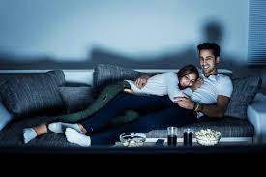
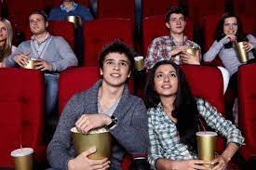
Why might these people have chosen to watch films in these locations
How might they be feeling

Slide 16
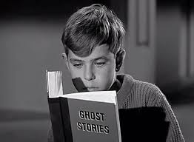
Why might these people have chosen to read in these situations ?
How might they be feeling?

