Slide 1
Writing/Email

Slide 2
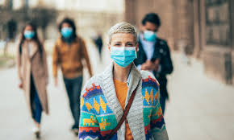
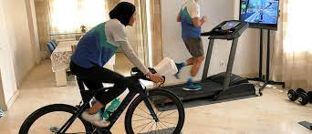
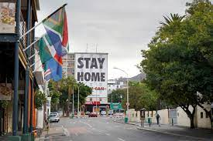

Slide 3
Prepare: Introduction to the lesson
Think about the questions below and make some notes in English in your notebook.
How has your routine changed since the outbreak of COVID-19?
Which of these changes have been positive and which have been more difficult?
Which change has had the most impact on your day-to-day life?

Slide 4
Prepare: Reading and Vocabulary
Read this blog post entitled ‘Life in Lockdown’ quickly for the main ideas, so don't stop to look up unknown words. Write the answer to the following question in your notebook:
a. Is Susan’s situation similar or different to your own? How?

Slide 6
Notice how the text is organised, each paragraph relates to a different topic. Match the following
headings to paragraphs A to D.
1) How my life has changed.
2) Looking on the bright side.
3) Lockdown in the UK
4) How my parents’ lives have changed.

Slide 8
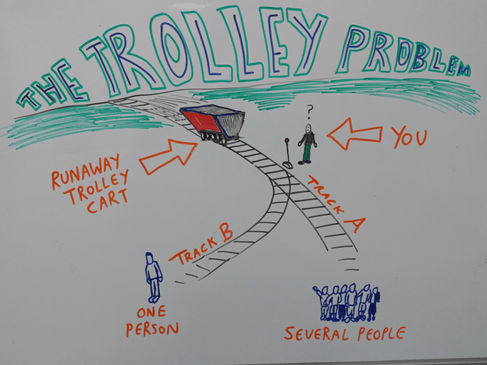
Ethical dilemma
The trolley problem is a concept often used in philosophy and ethics courses. If you haven’t heard of it before, it basically works like this:
imagine you’re standing beside a railway line (the reason why you’re there isn’t important). You suddenly see a large, heavy, unmanned train car (or trolley) coming down the track. It’s out of control and hurtling toward you at lethal speed.
You’re safe, but further down the track is a group of people who will almost certainly all be killed if the out-of-control trolley continues rolling along the track. There’s no time to shout a warning to those people or help them in any other way, except that you happen to be standing near a junction of the track, and the lever which controls whether trains or trolleys travel down a different track is right next to you.

Slide 9
You now have to make a decision.
You can either do nothing, and allow the runaway trolley to continue along the track it’s already on. Or, you can pull the lever and send the trolley along a different track. If the trolley goes down the alternative track, it will hit and kill one person.

Slide 10
Now use the strategies in the Top Tips box to help you match the underlined words in the text to the definitions below. The first one has been done for you.

Slide 11
Prepare: Research the topic
1) In her blog post, Susan mentions ‘sticking to a routine’ as a good strategy for making the best of things.
Do you think this is a good idea? Why? Why not? Write your ideas in English in your notebook.
2) Do you have any other ideas about ways of coping with life in lockdown? Make a list in your notebook.
3) Choose one of the following articles/videos to help you with Exercises 4 and 5.
a. The Guardian newspaper: The Experts’ Guide to Lockdown living
b. Ted.com: I’m incredibly anxious about coronavirus. What can I do?
c. BBC Newsround: How to boss being stuck at home
4) How many of your ideas from Exercise 2 are mentioned in the article/video you chose?
5) Add any new ideas to the list you made in Exercise 2.
6) What’s your favourite idea? How would you summarise it in a comment on Susan’s blog? Write your
idea in your notebook.

Slide 12
Prepare to write, prepare for success
1. Which of the following have you written recently?
• an essay for school or university
• a report or proposal
• an online review
• an email or letter
• a text message
Would you approach each piece of writing in Exercise 1 in the same way? Tick the ones you think are more formal? Underline the ones that might need more planning and preparation.

Slide 14
Now let’s look at how we can apply the P.O.W.E.R. process to our exam practice. Read the Steps to Success below and tick the ones you usually follow when you do Writing Paper exam practice tasks.

Slide 15
Steps to Success! Writing Part 2
1. Read the question carefully – underline the key words and make sure you include all of the information you are asked for. Who are you writing to? Should your style be formal or informal?
2. Use the language and ideas from the lesson – think about the vocabulary and ideas you researched in the preparation stages. What can you use to help you write your answer to the exam task? Susan organised her blog into paragraphs. Think about how you can do the same with your writing.
3. Now start the clock - use your phone, tablet or an online timer to time yourself doing the task.
• B2 First for Schools candidates should write 140 to 190 words and spend about 40 minutes on the task.
• C1 Advanced candidates should write 220 to 260 words and spend about 45 minutes on the task.
4. Make a plan – make a list of the ideas you want to include in your writingin your notebook. Now organise your ideas into paragraphs. You should spend around 5 minutes planning your answer.
5. Write – now write youranswer to the task. Aim to leave at least 5 minutes at the end to check your work. Don't waste time counting the words (leave this until you finish the task or your time is up).
6. Check your work – Common errors for most English learners include missing articles (a, an, the) and 3rd person –s. Check for these. It's a good idea to keep a list of your typical errors in your notebook then you can check for them too. See the writing checklist below for other ideas on what to look for.
7. Time’s up! Take a short break before you move on to Step 8. Go for a walk, make a drink and then come back.
8. Reflect on your performance using the writing checklist below. Ask your study partner for feedback too – it's always helpful to get a second opinion on your writing. This will help you focus on the areas you need to work on.

Slide 16
DESERT ISLAND DISCS

Slide 17
Practice: Practice Task for Writing Part 2
Now follow the Steps to Success to complete this Practice Task. Good luck!

Slide 18
Language

Slide 19
Dream Guests

Slide 20
Reflect: Self-reflection and peer feedback using a writing checklist
1. Use the checklist below to reflect on how well you did the task.
2. Give yourself a grade between 1 (lowest) and 5 (highest).
3. If you are working with a study partner, ask them to complete the checklist for you as well. Do your
assessments match?
4. What did you do well?
5. What do you need to work on next time?

Slide 22
Language
VOCABULARY
EXPRESSIONS

