Slide 2
Happy New Year!

Slide 3
What are the origins of New Year’s resolutions?

Slide 4
The origins of New Year’s Resolutions
The ancient Babylonians made promises to their gods at the start of each year that they would return borrowed objects and pay their debts.
The Romans began each year by making promises to the god Janus, for whom the month of January is named.
In the Medieval era, the knights took the “peacock vow” at the end of the Christmas season each year to reaffirm their commitment to chivalry.
At watch-night services (a mass late at night on the 31st December), many Christians prepare for the year ahead by praying and making these resolutions.

Slide 5
Discuss with your partner:
What are the most common New Year’s resolutions?

Slide 6
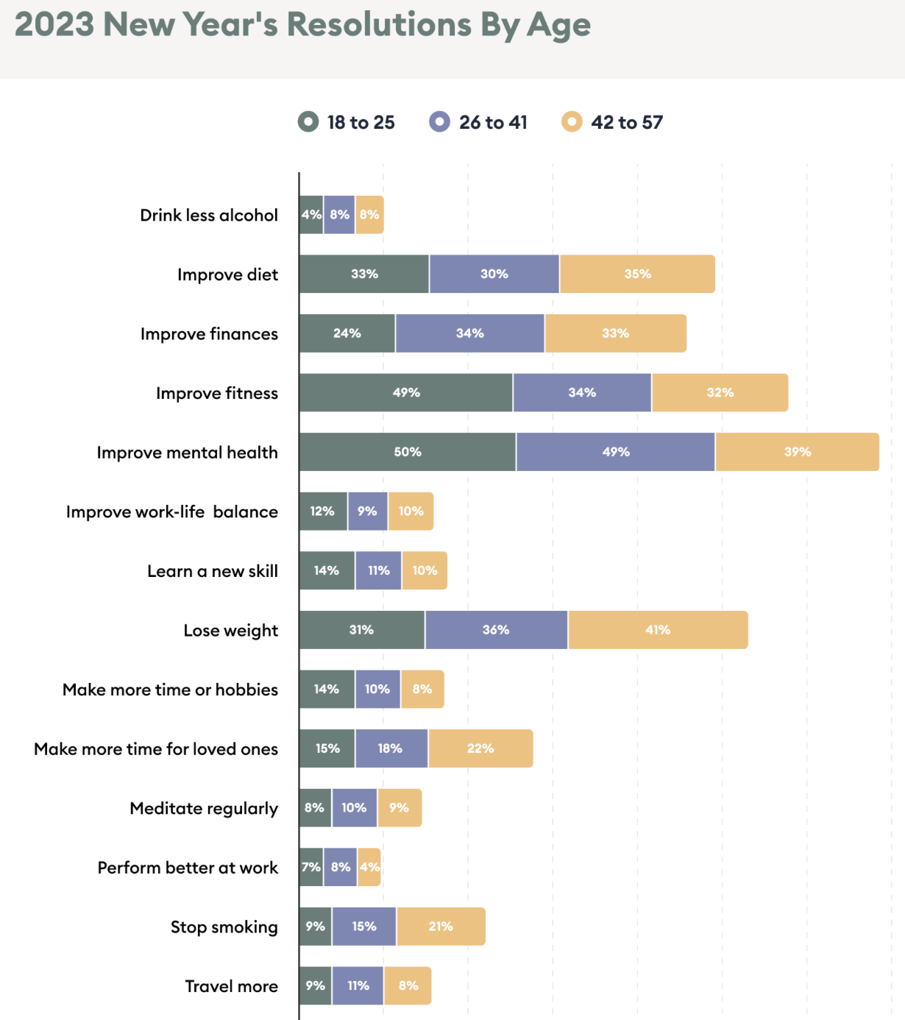
In your group, put the resolutions in order of difficulty from the most difficult to the easiest

Slide 7
Have you ever made any of these New Year’s resolutions? If not, have you tried to make these changes at any other point in the year.
Were you successful? Why? Why not?
If you have tried to do any of these things what advice would you give to your classmates to help them achieve their goals?
For example: How can you reduce stress in life?

Slide 8
What percentage of people who make a resolution keep it?
Why do so many people find it difficult to fulfil their New Year’s resolutions?
Who’s better at keeping them: men or women?

Slide 9
A study involving 3,000 people showed that 88% of those who set New Year resolutions fail, despite the fact that 52% of the study’s participants were conﬁdent of success at the beginning.

Slide 10
While women were more likely to set new year goals, men were significantly better at sticking to theirs, especially as they grew older. Among the participants, 51% of men met their goals, compared to 43% of women who reported meeting theirs.
Men achieved their goal 22% more often when they set small measurable goals (such as, lose 1kg every two weeks, instead of just saying “lose weight”).
Women succeeded 10% more when they made their goals public.

Slide 11
If everything goes to plan in 5 years, I’ll be…
I’ve got it all mapped out. First I’m going to… then…
I have absolutely no clue what I’m going to do tomorrow let alone in ___ years.
I have always had aspirations to go into the field of…
With any luck, I will probably…
I have a burning ambition to…
I’ve always dreamed of (verb +ing)… so I expect I will…
I’m torn between … and …. but I’m leaning towards studying/ working as…
In all likelihood I’ll follow in my Mum/Dad’s footsteps and become a…

Slide 12
Student A
What are your plans for this year?
What would be your ideal job? Why?
Do you have any special plans for this weekend?
What will you do when you finish school/university?
Do you have any resolutions this year? If so, what are they? If not, why not?
Student B
Where do you see your studies taking you in the future?
Where do you see yourself in 10 years?
What are your personal ambitions for 2022?
Do you have any holidays planned for this year? Where would be your perfect destination?
Would you like to move abroad? Why/ Why not?

Slide 13
https://ricardobarroselt.files.wordpress.com/2016/01/new-years-resolutions-the-guardian.pdf
To lose steam
There is no harm in +ing
to tailor something (to someone)
To shed weight
To fall prey to
Be feasible
To hit your stride
To tackle (a problem)

Slide 14
According to the text...
Why do people usually quit their new year’s resolutions?
What does the author like about Mark Zuckerberg’s new year’s resolution?
What is the author’s new year’s resolution?
What should people do in order to achieve their resolutions?

Slide 15
Are all of your plans and resolutions for 2021 feasible?
Would it be better that schools and universities tailor educational programmes to each child’s speciﬁc needs, or maintain a ‘one-for-all’ approach? How feasible and beneficial are each of these approaches?
Do you think not speaking English well can hold people back from a successful career?
In what ways do you fall prey to retail promotions and discounts?
Who do you ask for help if you need to tackle a difﬁcult problem at work, and at home? What problems might you have to tackle in the coming year?
What was the last big change you made? How long did it take for you to hit your stride?

Slide 16
